Slide 1
Top Trends in Dairy Products and Alternatives

Slide 2
April 2025
Notes:
Fill in date — Month YEAR (Four digits). Example, August 2024
Tips:
This slide should be included in all PowerPoints that are shared out externally. It can be easily hidden during presentations, right click on the slide in the left panel and click “Hide Slide”.

Slide 3
About Euromonitor International
Euromonitor International network and coverage

Slide 4
State of the industry
Top 5 trends shaping the industry
Future outlook
Key takeaways
Notes:
Tip - suggested voiceover:
I am delighted to have the opportunity to chat to you today about [insert a reaction statement here i.e., what I want my audience to think, feel or do, for example, ‘investing in healthier product portfolios’]
Tip: Convey Presentation Shape & Journey and Set Expectations
Briefly elaborate on each Point of Interest above OR give the audience a glimpse of the final Destination i.e., a concise, combined statement stating the reaction (what I want my audience to think, feel or do) and the motivation (the one reason, benefit or consequence that will persuade them), for example, ‘If you'd like to tap into the high consumer demand for healthy eating and be ahead of potential mandatory regulation in the nutrition space, it is pivotal to invest into healthier product offerings and continue to reformulate your current portfolio to achieve more nutritionally balanced food products.’

Slide 5
State of the industry
(Global)

Slide 6
STATE OF THE INDUSTRY
Dairy Products and Alternatives snapshot
216,165
Total market volume in tonnes in 2024
682 bn
Total market value in 2024
1.3%
Total market volume forecast CAGR 2024-2029
Source: Passport, Dairy Products and Alternatives, 2025 edition
Notes:
Global Dairy in USD, constant terms, fixed exchange rates
2020 good year: pandemic boost with foodservice to retail shift and stockpiling
2021 and 22 market correction
2022 strong inflation
2023 good year, consumers accepted price growth to certain degree, volumes suffer
2024 continuation of high prices, but to lesser extent
2025 and onward, pattern continues, high prices propping of value growth while volumes stagnate
Assuming no major global events like additional conflicts, pandemics, maybe not safe assumption, but baseline
Leads to 2% average growth
Where is growth coming from?

Slide 7
STATE OF THE INDUSTRY
Cheese and milk are the most important sources of growth
Source: Passport, Dairy Products and Alternatives, 2025 edition
Notes:
Which categories driving growth?
Cheese largest absolute value growth
A couple things to note
Plant based dairy growing strongest in percentage terms, but from small base. That 4.2% growth, only minor gains on overall animal based
Baby food, including formula, barely positive, many geos negative, declining fertility rates, not expected to change, expect continued stagnation

Slide 8
India is the leading growth market for dairy growth globally
STATE OF THE INDUSTRY
The USA is number two but most major growth markets are found in developing countries
Source: Passport, Dairy Products and Alternatives, 2025 edition
Notes:
Going back to dairy overall, largest growth markets
India, USA
One thing notice, mostly emerging markets
Yes to US, UK CA, but otherwise BR, RU, MX, large emerging market
Indicates shift in growth from developed to emerging
True in value

Slide 9
State of the industry
Top five players lose ground while private label grows supported by affordability and quality
Source: Passport, Dairy Products and Alternatives, 2025 edition
Source: Passport, Dairy Products and Alternatives, 2025 edition

Slide 10
E-commerce is the channel with the highest growth
STATE OF THE INDUSTRY
Source: Passport, Dairy Products and Alternatives, 2025 edition

Slide 11
State of the industry
(Regional)

Slide 12
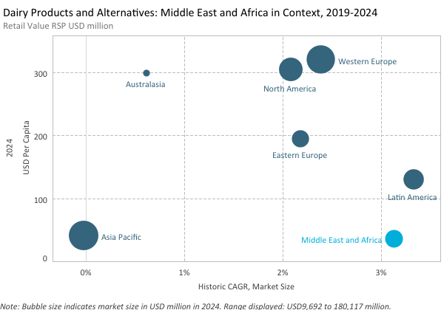
STATE OF THE INDUSTRY
Middle East and Africa records second strongest sales growth

Slide 13
STATE OF THE INDUSTRY
Growth momentum continues in 2024 thanks to easing inflation
65 bn
Total market value in 2024
+5%
Total market value growth 2024
+4%
Total market value forecast 2024-2029
Source: Passport, Dairy Products and Alternatives, 2025 edition
Notes:
Note: 6.4% is growth of the period. CAGR is 1.3%

Slide 14
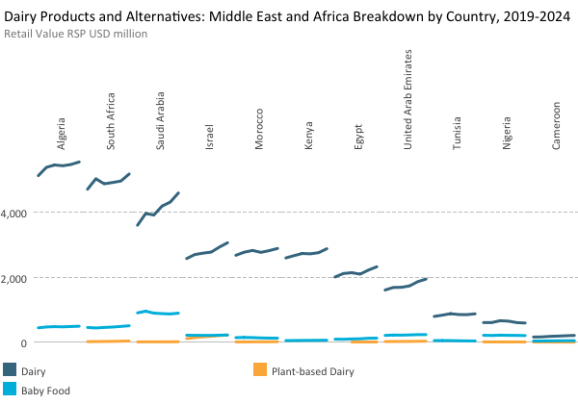
STATE OF THE INDUSTRY
Dairy increase in most countries driven by strong investments

Slide 15
STATE OF THE INDUSTRY
Modern grocery retailers lead in the Middle East

Slide 16
Consumers look for health benefits in dairy products, including digestive health, high protein and mental wellbeing
Top 5 trends in Dairy Products and Alternatives
Major dairy players and consumers share concerns about sustainability and are acting accordingly
Dairy products are increasingly participating in snacking occasions with convenient and portable packaging
Plant-based dairy keeps on developing, supported by health, sustainability, animal welfare and expanding portfolios
Private label continues to grow since consumers look for affordability in dairy products and alternatives

Slide 17
Consumers look for health benefits in dairy products
TOP 5 TRENDS SHAPING THE INDUSTRY
Consumers are looking for benefits in dairy products and alternatives for both their physical and their mental health
The global top 10 claims in dairy products and alternatives are illustrative of the main health benefits that the industry is offering
Increasing functionality is seen across the industry, including the most indulgent categories
Source: Euromonitor International, Passport
Notes:
Health and Beauty Claims System

Slide 18
Top trends

Slide 19
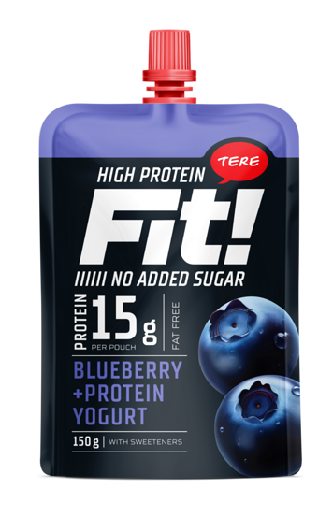
Choose only ONE: either Option 1 or 2
Case study slide suggested layout option 2.
TERE Fit!: Yoghurt with 15 grams of protein
Of European respondents say they participate in physical activity at least once per week, 2024
61%
Share of Dairy products with High Protein claim in Europe
5.9%
In Estonia, leading manufacturer of yoghurt, TERE, launched Fit!, yoghurt with high protein, fat free and with no added sugar, for consumers who practise exercise routines. Packaging is suitable for on-the-go consumption.
Value Share of TERE in yoghurt, Estonia, 2024
16%
Source: 1) Euromonitor International, Voice of the Consumer: Lifestyle Survey 2024, 2) Euromonitor International, 3) Passport, Dairy 2025 edition
Source: tere.eu

Slide 20
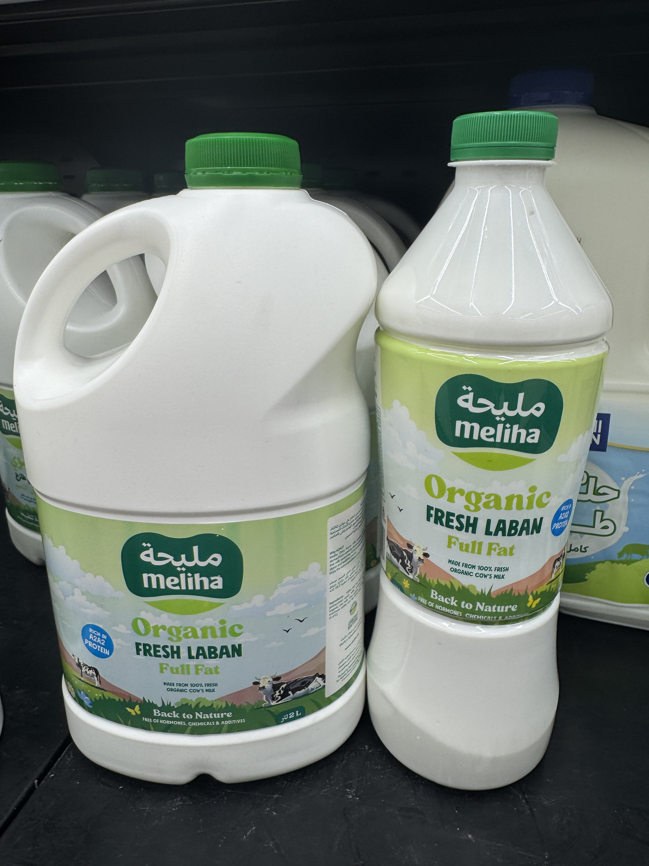
Choose only ONE: either Option 1 or 2
Case study slide suggested layout option 2.
Meliha Organic Laban: UAE’s first A2A2 dairy
Forecast CAGR of cow’s milk in UAE
5.5%
Meliha laban was launched in January 2025 after the successful launch of Meliha milk in August 2024.
Meliha dairy focuses on producing milk rich in A2A2 protein, renowned for its numerous health benefits.
Of UAE respondents strongly agree that they like to try new products and services
23.8%
Of UAE respondents try to have a positive impact on environment through their everyday actions
25%
Source: 1) Passport, Dairy 2025 edition; 2) and 3)
Euromonitor International, Voice of the Consumer: Lifestyle Survey 2024
Source: Own photo

Slide 21
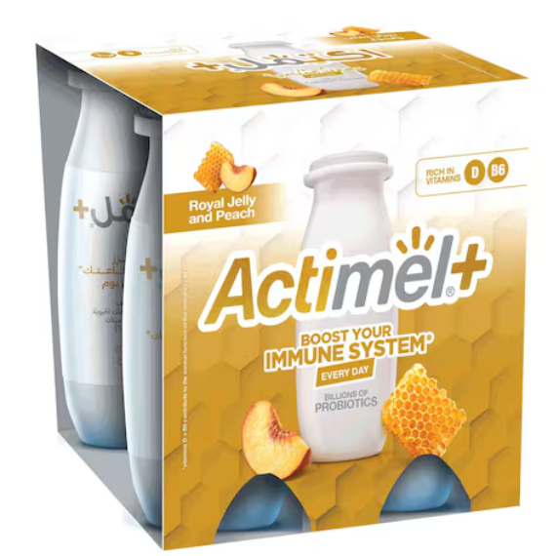
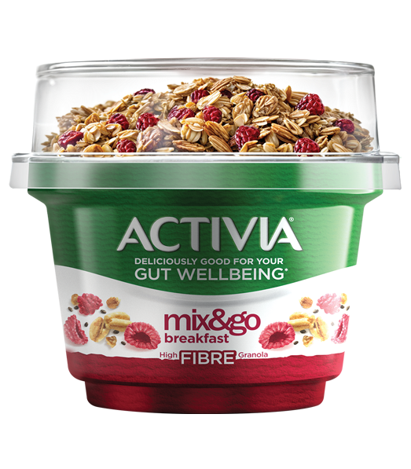
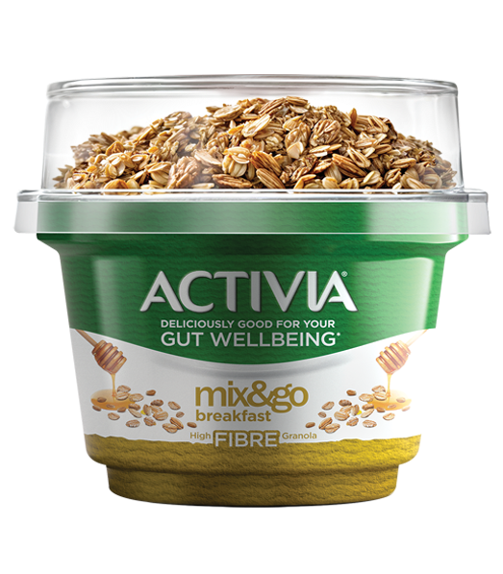
TOP 5 TRENDS SHAPING THE INDUSTRY
Danone innovates on immune system and gut health dairy
Source: activiaarabia.com
Source: activiaarabia.com
Actimel+ launches new SKU with immune system support
Activia strengthens gut health positioning
In Saudi Arabia, Al Safi Danone launched Actimel+ with a positioning to improve the immune system with billions of probiotics and rich in vitamins D and B6. It is available in two flavours: Royal Jelly and Peach, and Lemon Ginger.
Al Safi Danone launched Activia Mix&Go breakfast with focus on gut wellbeing and high fibre. It contains probiotics that promote digestive health and overall wellbeing. The packaging is suitable for on-the-go consumption and ideal for a quick and healthy breakfast or snack.

Slide 22
Dairy products increasingly participate in snacking occasions
TOP 5 TRENDS SHAPING THE INDUSTRY
With consumers having busier lifestyles, dairy products that enable on-the-go consumption, or quick and easy meal solutions, are flourishing
Products such as yoghurt sticks and pouches, drinkable dairy products and cheese are increasingly participating in snacking occasions for consumers with active lifestyles who still want to maintain healthy diets
Source: Euromonitor Voice of the Consumer: Lifestyles Survey, fielded January-February 2023/2024

Slide 23
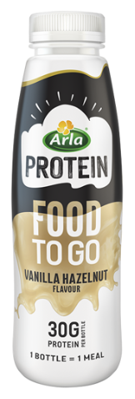
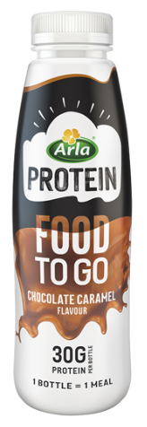
Arla: milk-based products for meal replacement
Of Danish respondents say they do not have time to cook
15.5%
Of Danish respondents look for health and nutritional properties in food & drinks
31.8%
Arla Protein Food To Go is a milk-based drinkable meal launched in September 2024 in the UK and Denmark.
Aimed at consumers on busy days. One bottle corresponds to one meal for an average adult.
Of Danish respondents reheat or prepare ready-meals at least once per week
43.4%
Source: Euromonitor International, Voice of the Consumer: Lifestyle Survey 2024
Source: www.arlafoods.co.uk

Slide 24
Plant-based dairy develops with expanding portfolios
TOP 5 TRENDS SHAPING THE INDUSTRY
Health, environmental concerns and animal welfare are the key drivers fuelling the growth of plant-based dairy. Its increasing portfolio, sophistication and functionality are supporting its good performance.
To enhance competitiveness, manufacturers in the plant-based dairy sector should focus on non-soy milk offerings by improving quality, taste, and functionality.
Source: Passport, Dairy Products and Alternatives, 2025 edition

Slide 25
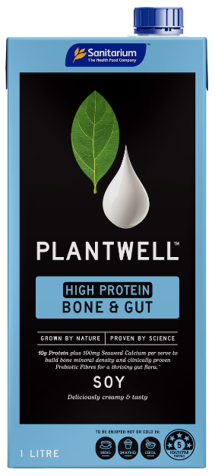
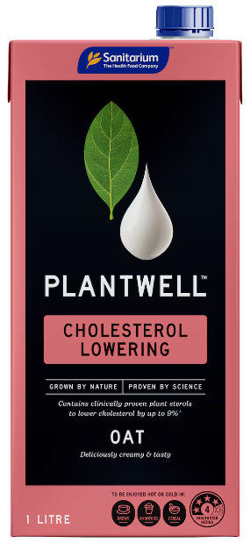
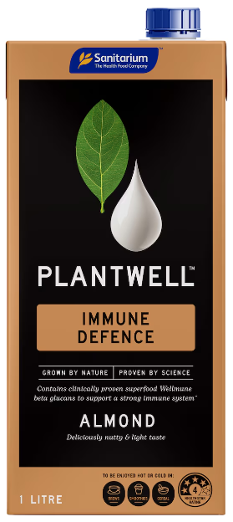
PLANTWELL: plant-based drinks with health benefits
Million AUD retail value sales recorded in 2024 for plant-based dairy
488
Y-o-y growth growth in retail value in 2024
5.6%
In Australia, Sanitarium Health Food Company launched a line of three plant-based drinks: A high protein soy milk to build bone density, a cholesterol lowering oat milk, and an almond milk to strengthen immunity
CAGR expected for 2024-2029
3.3%
Source: Passport, Dairy Products and Alternatives, 2025 edition
Source: www.woolworths.com.au

Slide 26
Private label grows as consumers look for affordability
TOP 5 TRENDS SHAPING THE INDUSTRY
With decreasing consumer purchasing power, private label is becoming increasingly attractive. Global value share went from 12.8% in 2019 to 14.9% in 2024.
Private label is predominantly found in the cow’s milk category, but it has expanded to more categories and has increased in quality and sophistication
Companies must emphasise attributes, such as functionality and/or sustainability, to maintain competitiveness.
Source: Euromonitor Voice of the Consumer: Lifestyles Survey, fielded January-February 2023 n=40,391, 2024 n=39,943

Slide 27
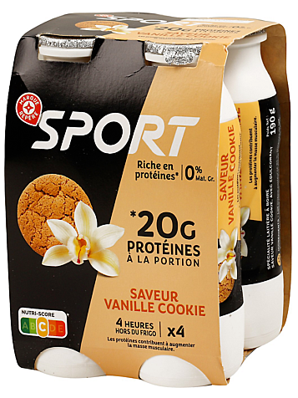
SPORT: Private label adds functionality
In France, leading retailer Leclerc launched Sport in 2024, a line of dairy products with high protein content. It is offered in stylish flavours, exemplifying the premiumisation of private label.
Source: Passport, Dairy Products and Alternatives, 2025 edition
Source: e.leclerc.com

Slide 28
Dairy players and consumers are concerned about sustainability
TOP 5 TRENDS SHAPING THE INDUSTRY
Almost two thirds of consumers globally try to have a positive impact on the environment through their everyday actions
When buying food, one of the most sought-after attributes include locally-sourced products, which consumers are choosing for its lower environmental impact, the fewer farm-to-fork miles, to support the local community and the economy, and for fresher taste.
Source: Euromonitor Voice of the Consumer: Sustainability Survey

Slide 29
Sustainability: Local production and support to local communities are important attributes for consumers
TOP 5 TRENDS SHAPING THE INDUSTRY
Source: Euromonitor Voice of the Consumer: Sustainability Survey, fielded January-February 2023
Source: Euromonitor International Sustainability Claims Tracker

Slide 30
Future outlook

Slide 31
FUTURE OUTLOOK
India’s development and the US cheese market will drive industry growth
Source: Passport, Dairy Products and Alternatives, 2025 edition
Source: Passport, Dairy Products and Alternatives, 2025 edition

Slide 32
FUTURE OUTLOOK
GDP per capita and population growth will contribute to the growth of the industry
Growth decomposition, Retail Volume Sales ‘000 Tonnes, 2024-2029, Dairy Products and Alternatives, Total
Growth decomposition, Retail Volume Sales ‘000 Tonnes, 2024-2029 CAGR %, by Category, Total
Source: Euromonitor International Dairy Products and Alternatives Forecast Model
Notes:
Growth of unit prices in 2022-2023 had a significant influence on the negative growth of dairy products and alternatives in those years.
With inflation easing, the industry is expected to show flat volume growth in 2024 and increasing growth rates over the forecast period. Population growth and GDP per capita are two of the main drivers of future growth.
Within dairy products and alternatives, plant-based will experience the highest growth, pushed strongly by product portfolio expansions, moderate unit price increases, and consumer concerns about sustainability and health.
Baby food is set to show the lowest growth, driven by higher growth in unit prices and declines in birth rates.

Slide 33
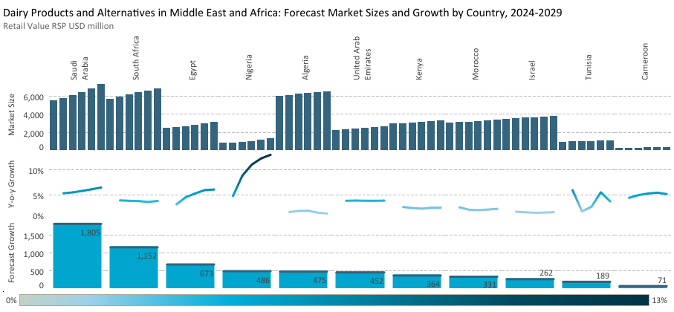
Bright future ahead for dairy products and alternatives in the region
Notes:
The market for dairy products and alternatives in Saudi Arabia is expected to continue to develop during the five years to 2029, with the rate of annual volume growth set to accelerate as the forecast period progresses. This will be fuelled by a rising population and increased workforce participation, particularly among Saudi nationals and women, which will boost both overall demand and household spending.
The number of international tourists to the country is also expected to increase, especially for religious pilgrimages, which should contribute to a positive performance for foodservice outlets. Indeed, Saudi Arabia is actively seeking to attract more international visitors to the country, as outlined in its Vision 2030 plan, which centres around economic and social reform. Growth in foodservice will also be boosted by improved macroeconomic conditions in the Kingdom, which will encourage local residents more inclined to eat out on a regular basis.
In the UAE, particularly the emirate of Abu Dhabi, quality control and health officials in the emirate have introduced a new nutrition grading system, set to be mandatory for five food items including dairy by 1 June 2025, as part of efforts to address rising obesity rates among residents. Supermarket products lacking the Nutri-Mark label, which evaluates the nutritional content of food items, will be removed from shelves, and violators will face fines. The same penalties will apply to products displaying an incorrect grade. This is expected to lead dairy players to launch products with health and wellness positionings.

Slide 34
Key takeaways

Slide 35
Key takeaways
Health benefits
Snacking occasions
Consumers are looking for benefits in dairy products and alternatives for both their physical and their mental health
Producers should embrace the opportunities arising from busy lifestyles, where dairy products can serve as convenient meal replacements
Plant-based Dairy
Affordability
Sustainability
Manufacturers in the plant-based dairy sector should focus on non-soy milk offerings by improving quality, taste, and functionality
With the higher capabilities and range of private label, companies must emphasise added value attributes to maintain competitiveness
Consumers choose locally-sourced dairy for lower environmental impact, fewer farm-to-fork miles, support to local community and economy, and fresher taste

Slide 36
Thank you!
Monique Naval, Global Project Lead
Monique.Naval@Euromonitor.com
https://www.linkedin.com/in/moniquealelinaval/

