Slide 1

Economic aspects of dairy farming
Rauf Mailov

Slide 2
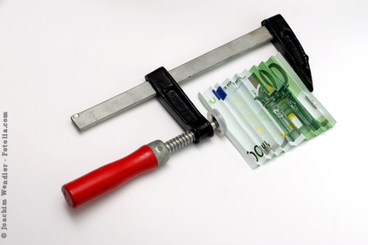
Economic situation - pressure to cut costs
Variable costs – WHEN and WHERE?

Slide 3
Where do you start in your farm?
Quelle: Dr. G. Dorfner, LfL, ergänzt und modifiziert

Slide 4
Life effectiveness
Target values ​​for life effectiveness: FV 13 kg/day of life
SB 15 kg/day of life
Good life effectiveness is possible!!
Quelle: LAZ BW, Versuchsbericht Nr. 1 2010

Slide 5
Life effectiveness
Wasted potential – with high economic damage
40 kg
2
Increase milk production
+++
Lactations
+++
Opportunities to improve life effectiveness
1500 €
Optimize (shorten) the rearing period
Extend performance life
+
3
Unused potential
1
-
Rearing costs
Years
Average culling period
1500 €

Slide 6
Life effectiveness
The reasons for a (too) short service life.
We're not getting to the performance selection stage!
Datenbasis: Uwe Eilers,
Aulendorf, 2007

Slide 7

Conclusion
The dairy farms don´t have much money for burning
Also you !

Slide 8
Thank you for your attention !

