Slide 1
AGRICULTURE AND DAIRY’S CONTRIBUTION TO SOCIO-ECONOMIC SUSTAINABILITY IN NENA

Slide 2
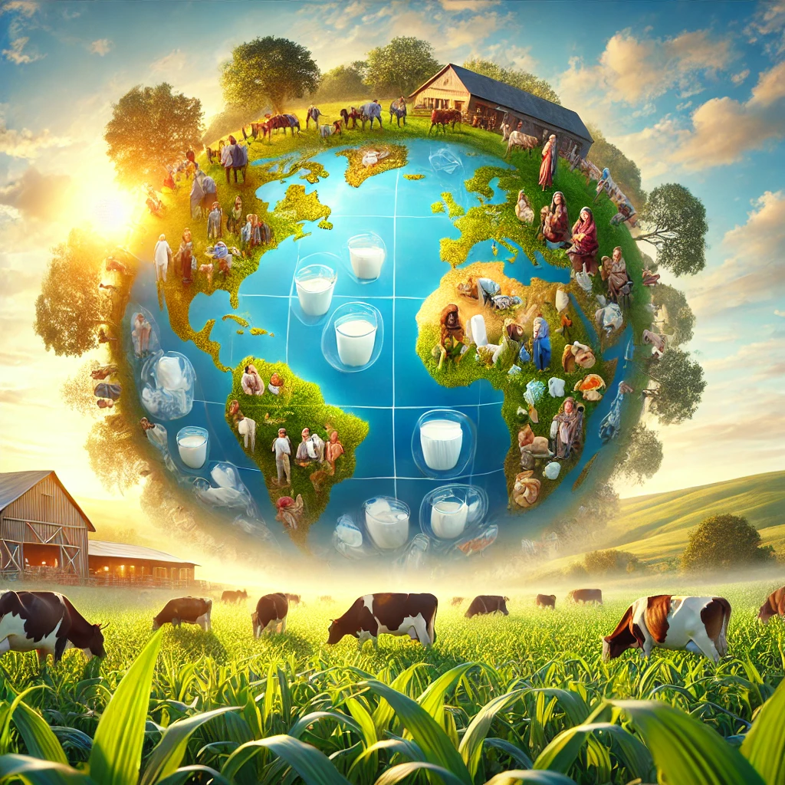
GLOBAL DAIRY SECTOR’S SOCIO-ECONOMIC IMPACT
Nourishes 6 billion people
Provides livelihoods for 1B+
150M farm households
750M people are engaged in milk production
Sources: FAO, IFCN

Slide 3
MILK PRODUCTION
OECD agricultural outlook 2023
See also Rabobank forecast dairy production and consumption
IFCN

Slide 4
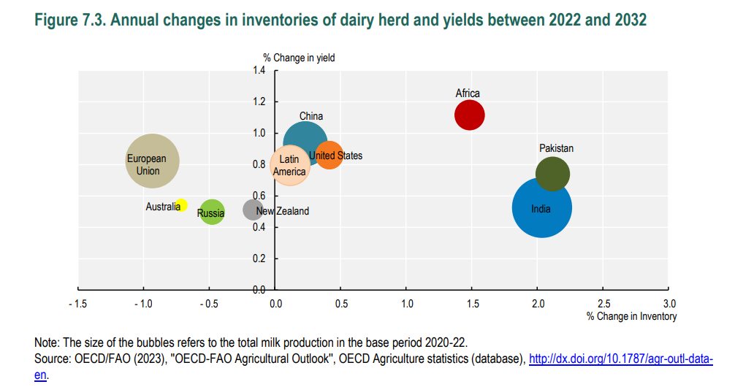
SIZE OF DAIRY HERD

Slide 5
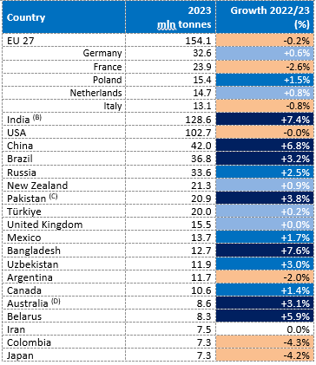
MILK PRODUCTION TOP 20 COWS’ MILK PRODUCERS IN 2023
(B) Dairy years ending March of the following year.
(C) Dairy years ending June of the following year; milk production for human consumption.
(D) Dairy years ending June of the following year.
Source: CNIEL, ZuivelNL, FAO, IDF National Committees, national statistics.

Slide 6
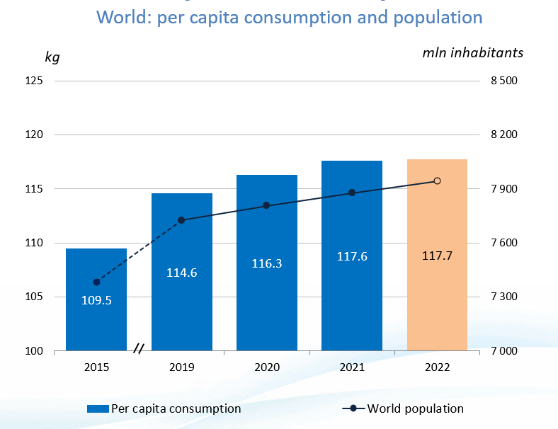
DEMAND
IDF World Dairy Situation - 2023

Slide 7
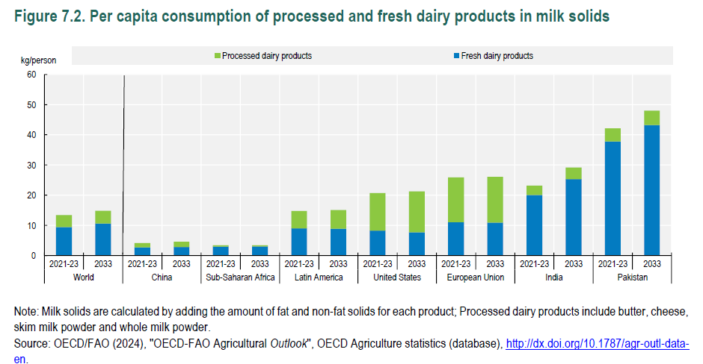
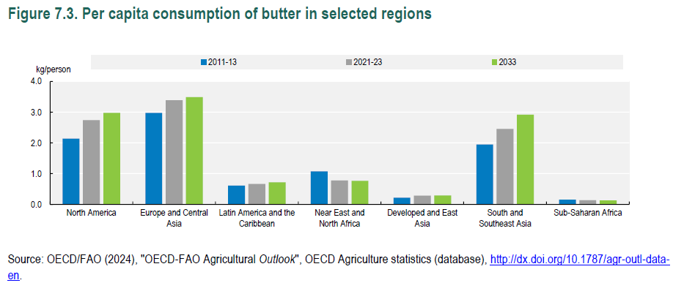
GLOBAL CONSUMPTION

Slide 8
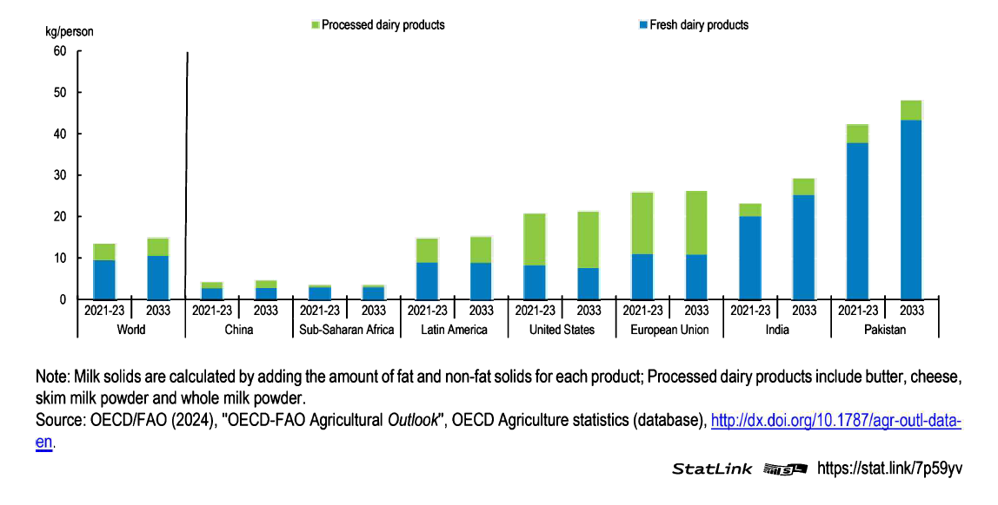
PER CAPITA CONSUMPTION OF PROCESSED AND FRESH DAIRY PRODUCTS IN MILK SOLIDS

Slide 9
SOCIO ECONOMIC INSIGHTS ON AGRICULTURE IN NENA

Slide 10
SOCIO ECONOMIC INSIGHTS ON AGRICULTURE IN NENA
The NENA region faces significant environmental challenges, with about 86% of its total land area suffering from degradation and desertification. This threatens the livelihoods of 410 million people
However, there are opportunities for sustainable and inclusive development through initiatives like the NENA Regional Investment Framework for Ecosystem Restoration and Development Solutions
The socio-economic impact of agricultural challenges, such as the spread of Xylella fastidiosa, includes declining yields, production, profitability, and employment, particularly affecting olives, citrus, and grapes
Efforts to enhance investments in ecosystem restoration are critical to addressing environmental challenges in NENA that threaten socio-economic stability, such as land degradation, water scarcity, and climate change

Slide 11
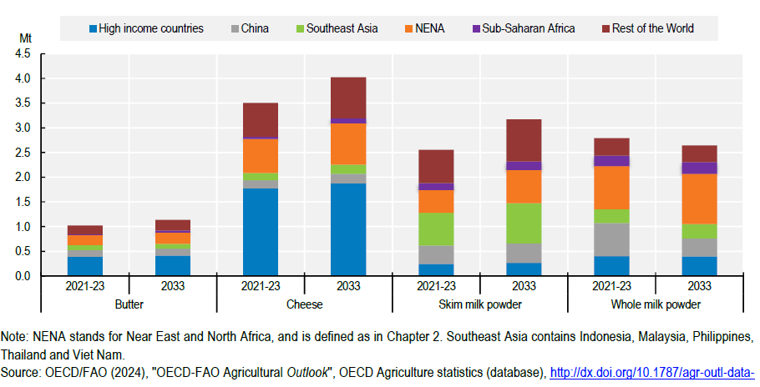
IMPORTS OF DAIRY PRODUCTS BY REGION

Slide 12
HOW DOES IDF SUPPORTS THE DAIRY SECTOR

Slide 13
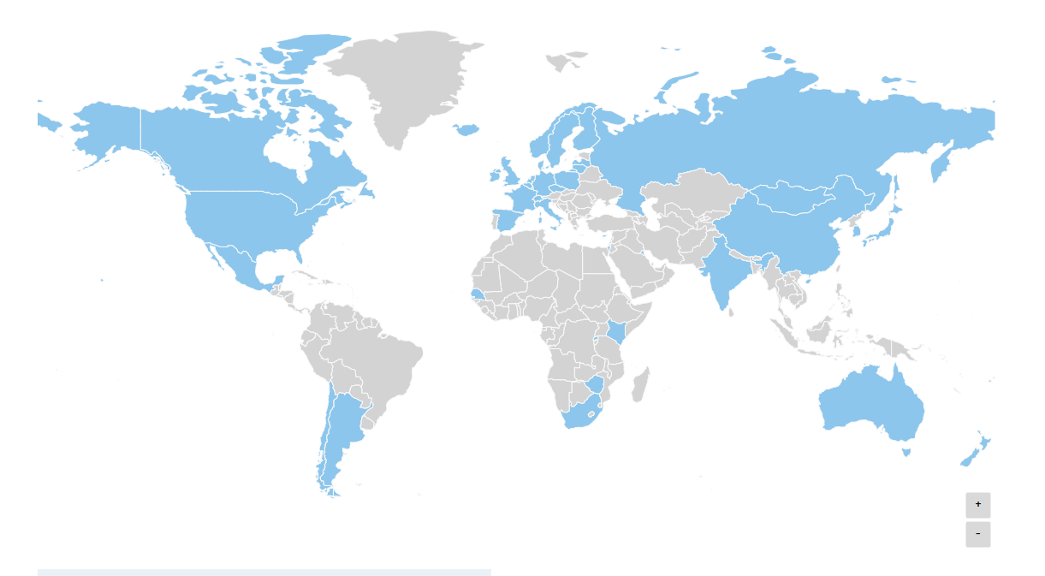
GLOBAL REACH
Established in 1903
Members in 40 countries representing 2/3 of world milk production
Accredited to the FAO, Codex, WOAH, UNEP, UNFCCC, ISO, ECOSOC
Collaborate with IGO’s and several other international organizations – IICA, GDP, DSF, WFO, OECD, GASL, FEPALE, etc.

Slide 14
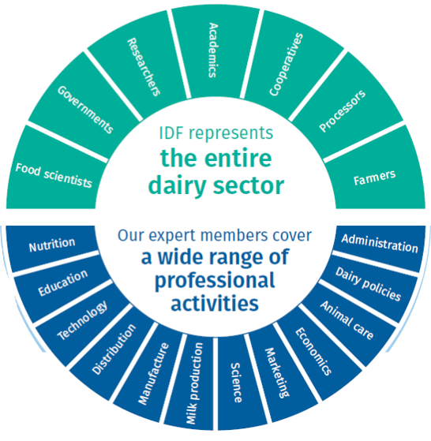
REPRESENTING THE ENTIRE DAIRY SECTOR
Dairy Farmers
Milk processors
National dairy organizations
Academia/non-profit research institutes
Government (Ministry of Agriculture)
Suppliers
Milk Sector Employees

Slide 15
ENGAGEMENT WITH STAKEHOLDERS
FAO
CODEX
WHO
WOAH
ISO
CFS
OECD
WVA
GDP
GASL
ICAR
IICA
DSF
LEAP
IUFOST
…

Slide 16
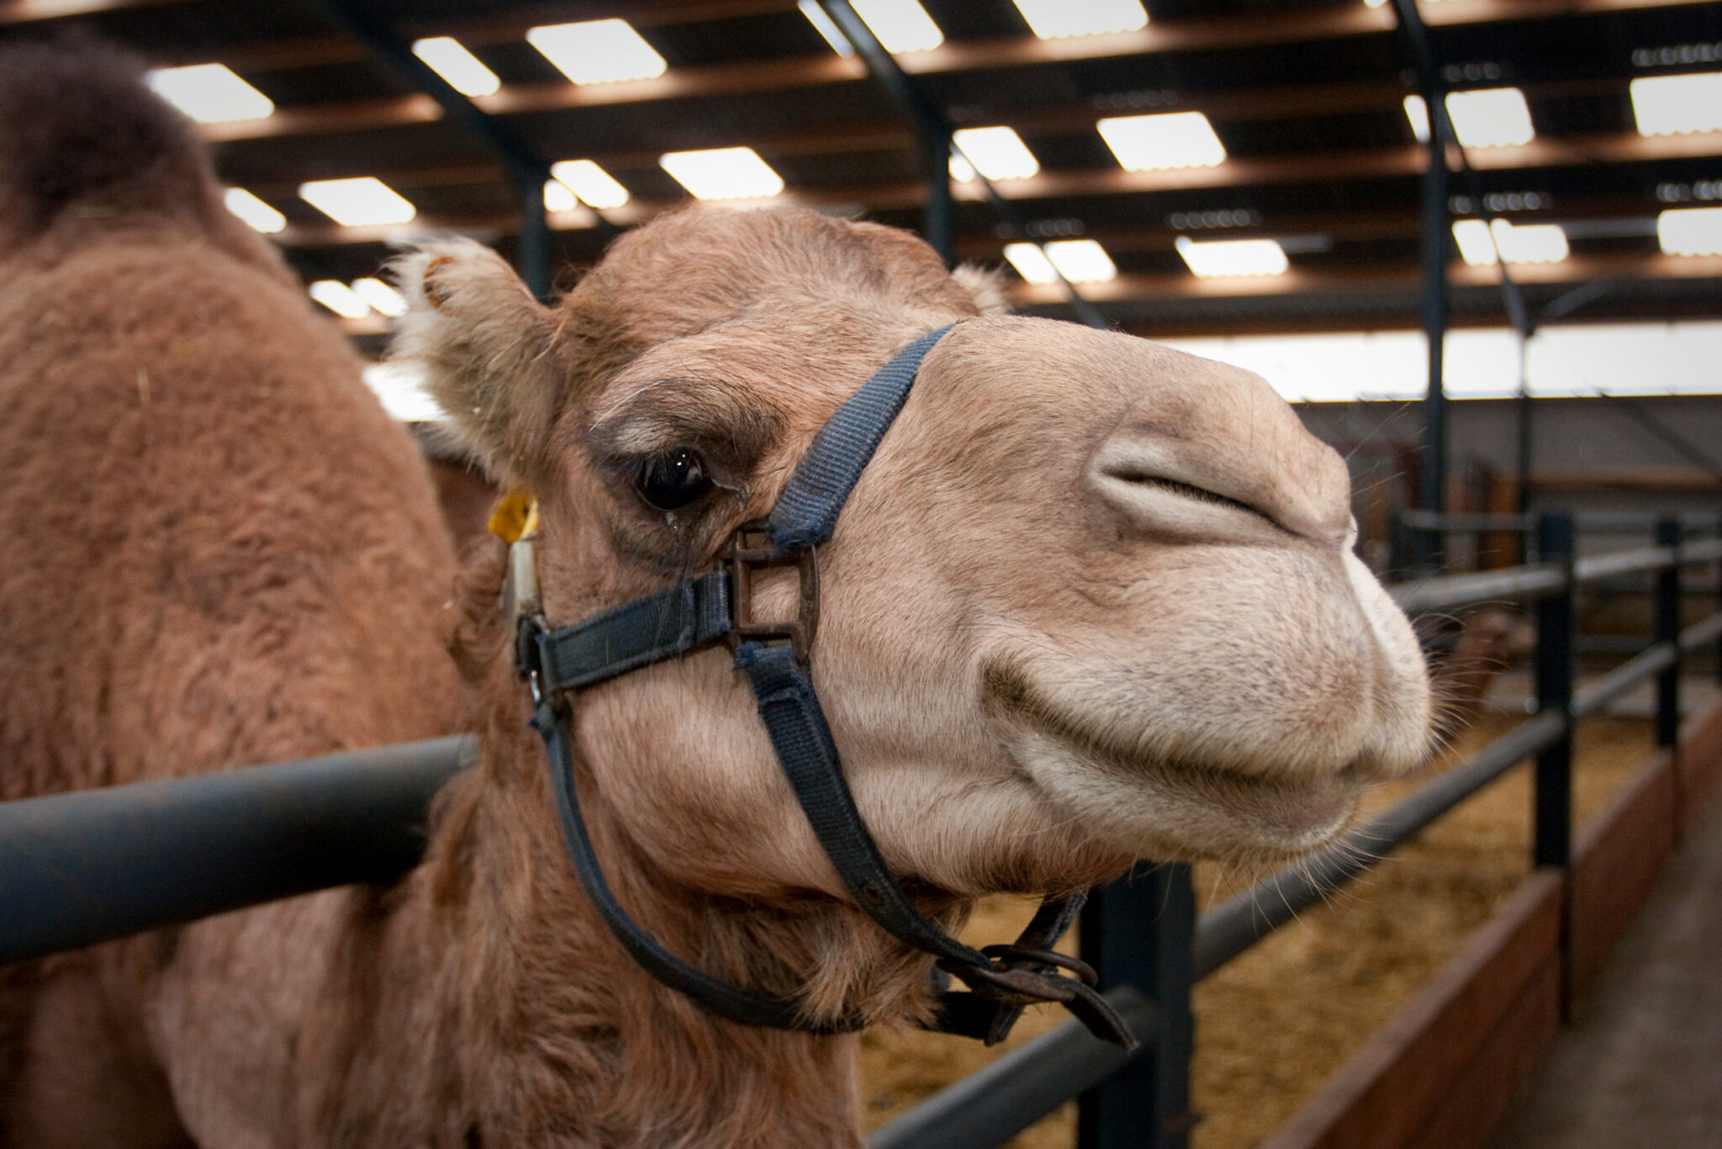
IDF IS THE SECTORS’ MAIN PLATFORM TO ADDRESS GLOBAL CHALLENGES AND OPPORTUNITIES
Considerations to be given to the role dairy plays in nourishing and livelihoods.
Global challenges – local solutions
Trade offs
Setting up enabling environments that support dialogue with all actors to consider holistic approaches

Slide 18
STANDARD COOPERATION MILESTONES TO SUPPORT FOOD SAFETY AND FAIR TRADE
1903
1947
1963
1995
2024
Technical Barriers to Trade (TBT) & Sanitary and Phytosanitary Measures (SPS) agreements

Slide 19
CODEX – ADVOCACY WORK – ON-GOING
CCMMP – Milk and Milk products (adjourned sine die)
CCFH – Food Hygiene
CCFA – Food additives
CCMAS – Methods of Analysis
CCFL – Food Labelling
CCNFSDU – Nutrition and Foods for Special Dietary Uses
CCFICS – Food Import and Export Inspection and Certification Systems
CCCF
CAC
General Standard for the Use of Dairy Terms
Water reuse – Dairy Annex for adoption – annex on technologies
Dairy provisions in General Standard Food Additives
Nitrates
Allergen labelling
Probiotics
Food fraud
Aflatoxin B1 in feed for milk animals
Gap analysis on Codex standards applicable to Camel milk
Aflatoxin M1
E-commerce
Allergens
NRVs
Cargoes
Env inhibitors/
Milk and milk products standards
Revision on guidelines on Listeria
Use of technology
packaging
Moisture
Analytical methods
Traceability
Added sugars
recycling

Slide 20
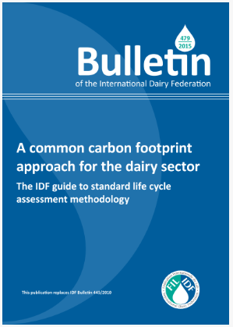
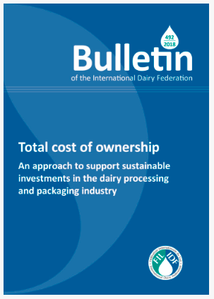
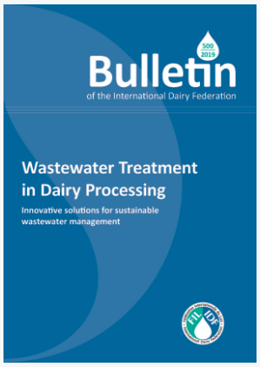
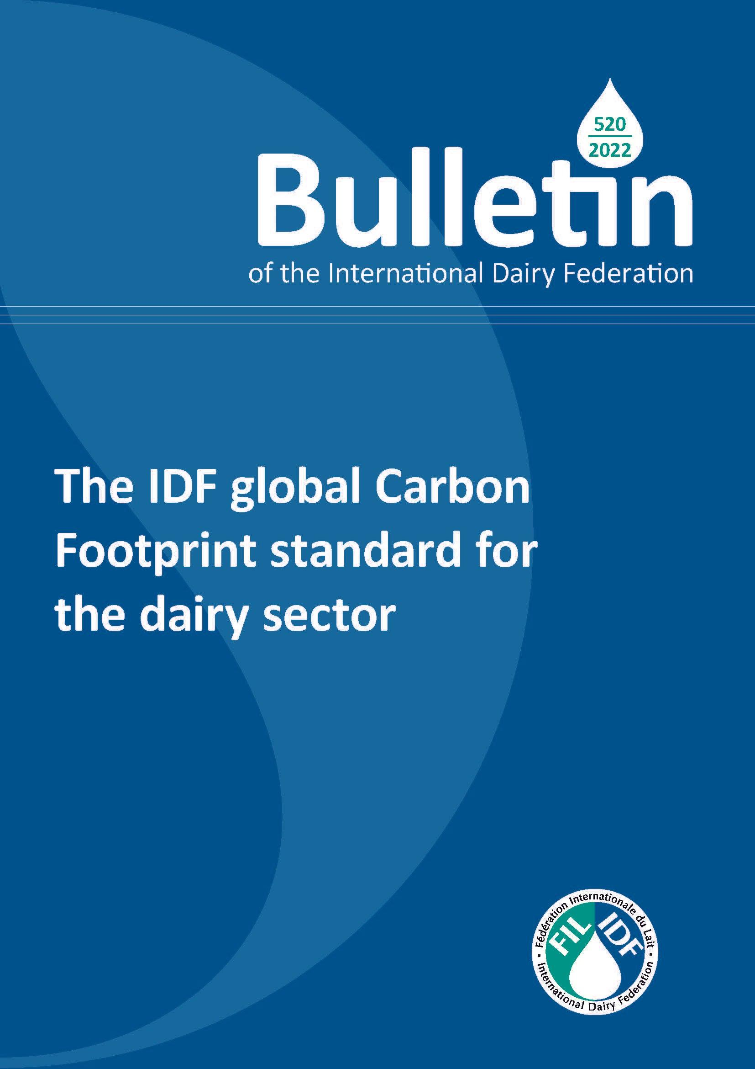
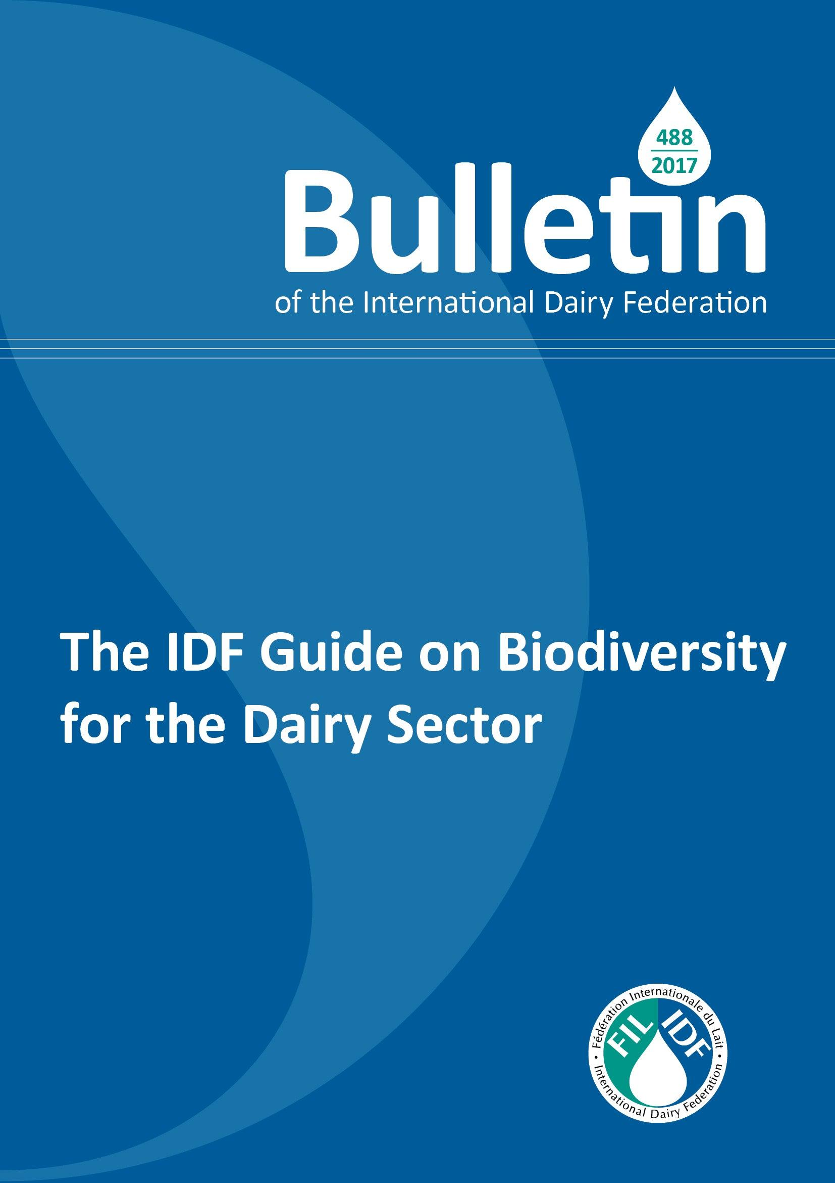
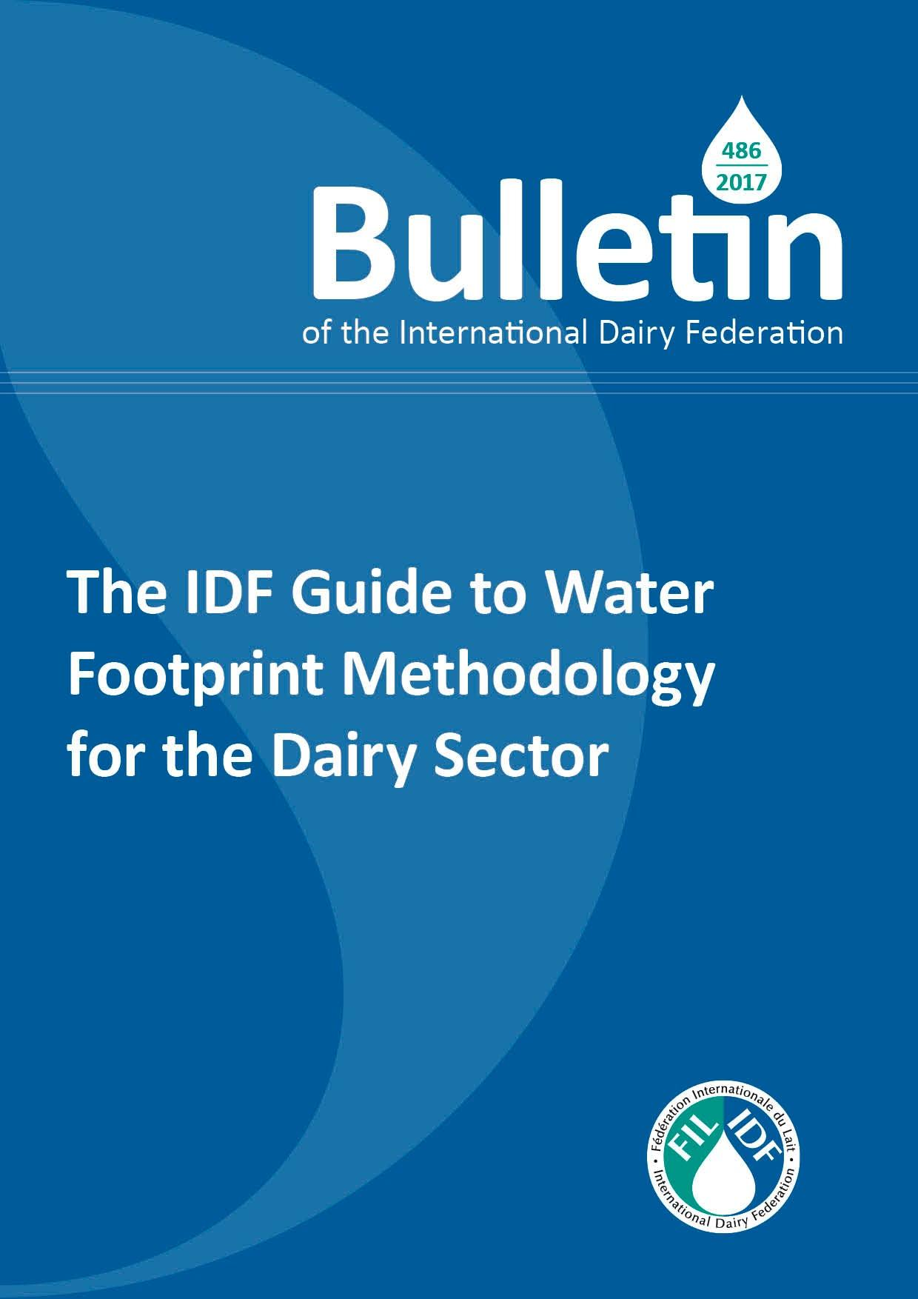
IDF METHODOLOGIES AND ENVIRONMENTAL SUSTAINABLE PRACTICES
2017

Slide 21
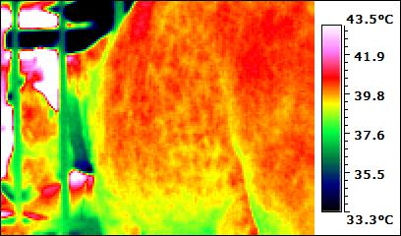
HEAT STRESS IN DAIRY CATTLE
Publication February 2025

Slide 22
IDF EVENT ON NON-COW MILK
Session 1: Sustainability Session 2: Sustainable milk production
Session 3: Sustainable animal health strategies
Session 4: Novel milk products & health impact
Session 5a: Processing Technologies
Session 5b: Processing Technologies
Session 6: Quality and Safety
Session 7a: Udder Health
Session 7b: Udder Health

Slide 23
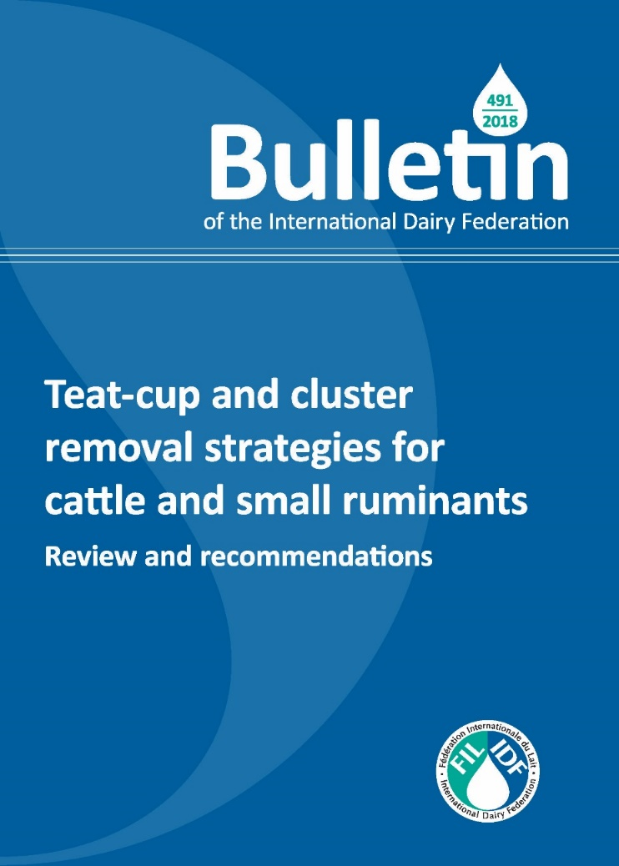
IDF ADVOCATES FOR GOOD MILKING PRATICES
New ISO standard on milking and cooling machine installations

Slide 24
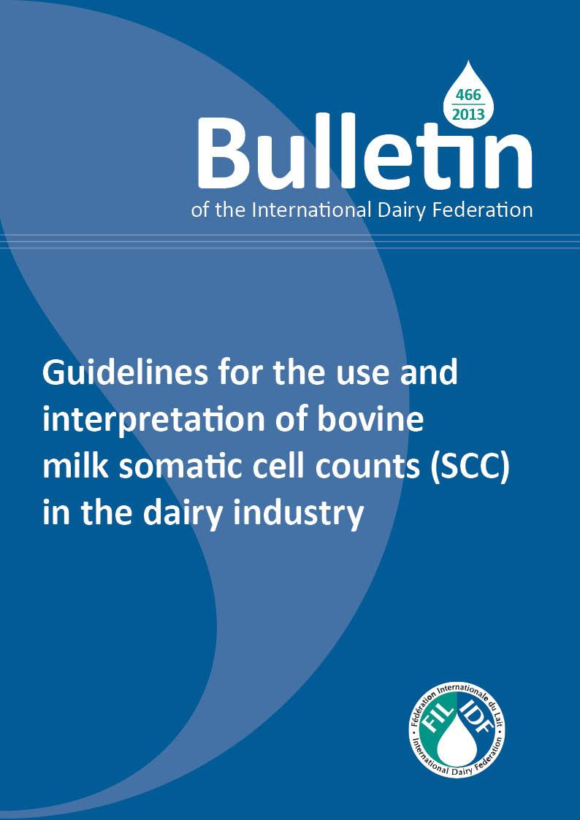
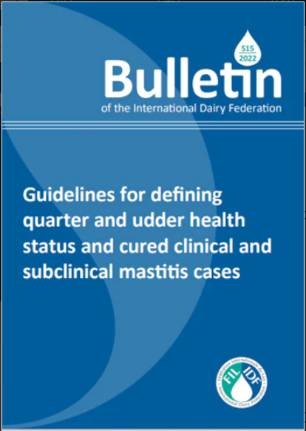
IDF DEFINES MASTITIS TERMINOLOGY
IDF Bulletin 2025
Guidelines for interpretation of goat milk somatic cell count (SCC) in the dairy sector

Slide 25
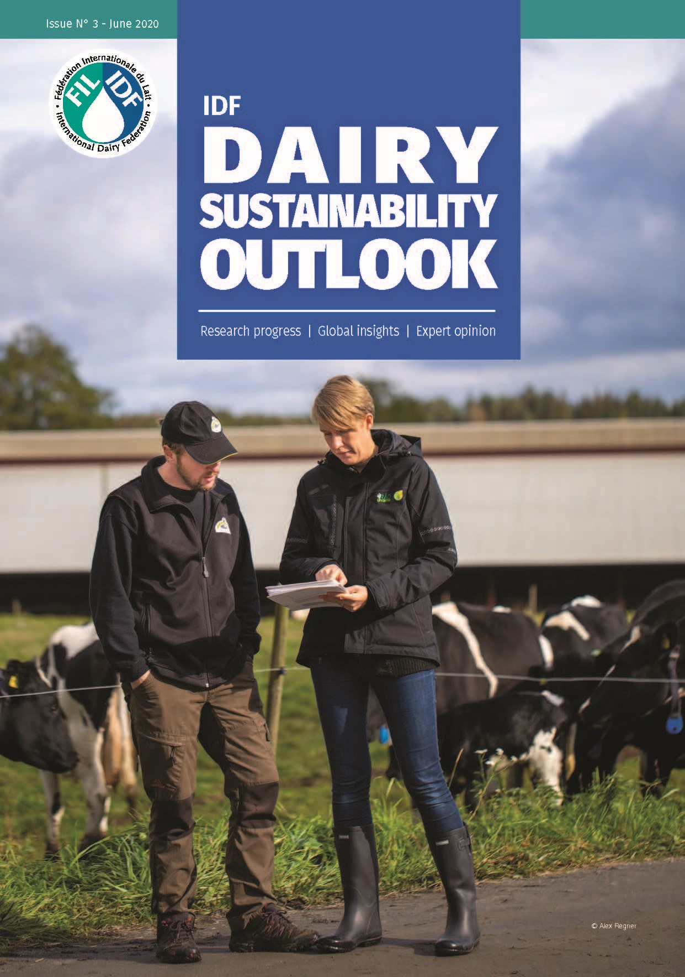
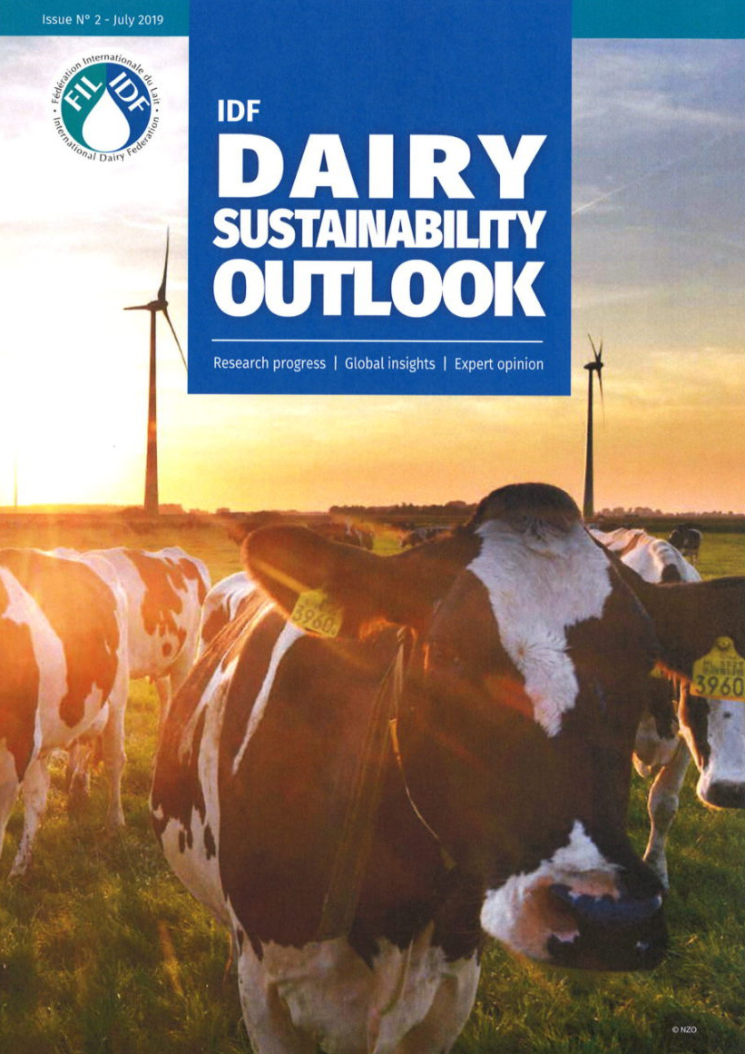
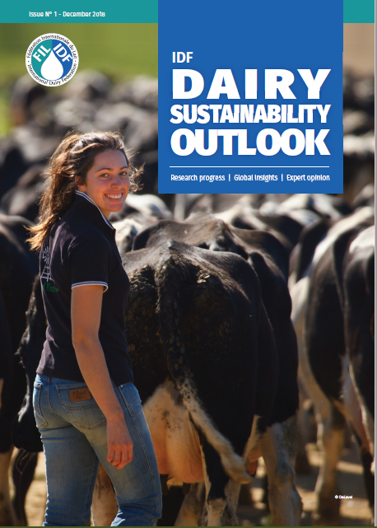
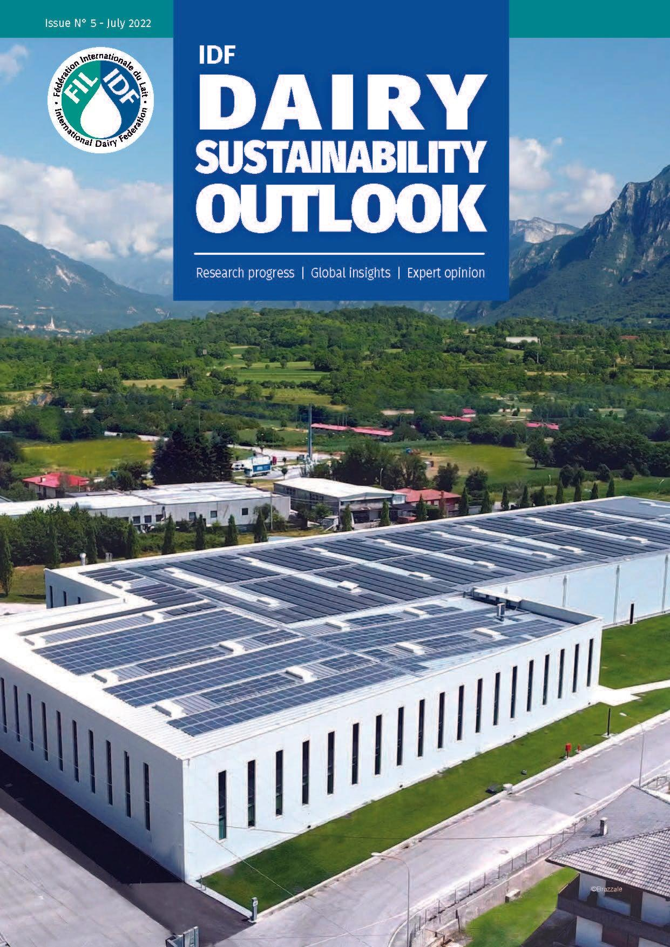
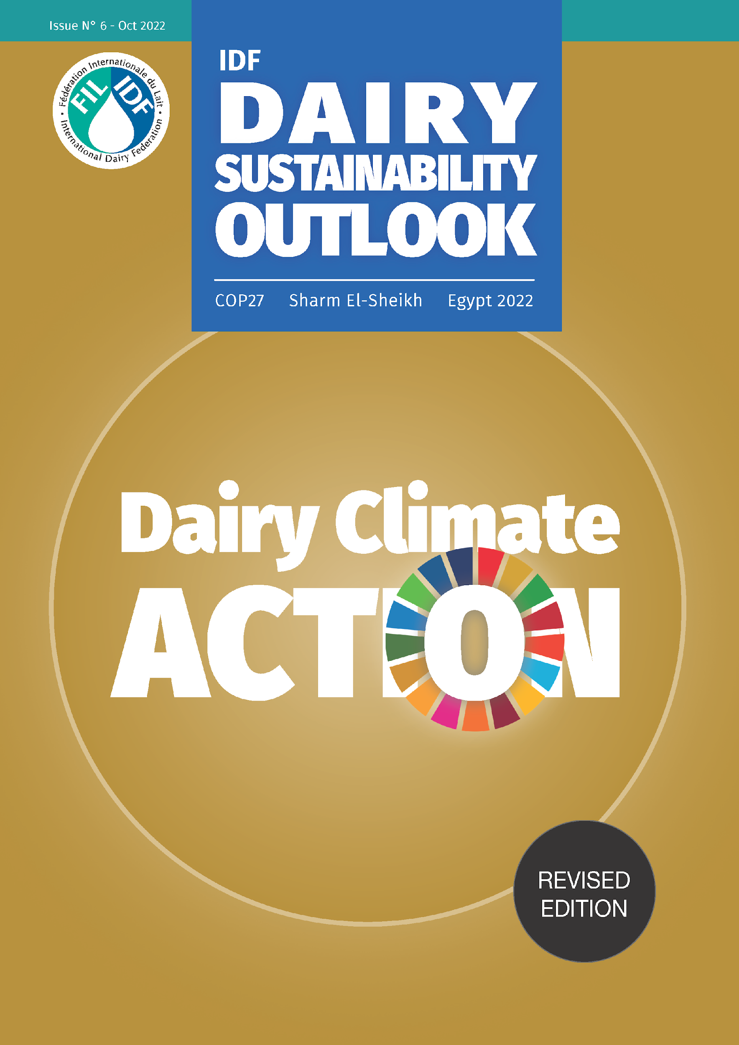
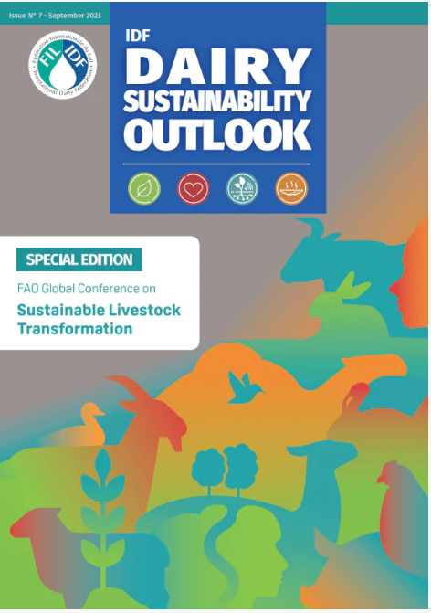
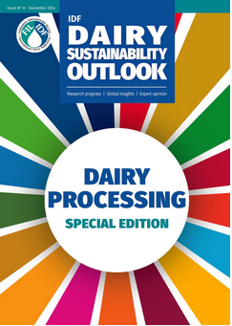
CASE STUDIES OF SUSTAINABLE PRACTICES & INNOVATIONS ACROSS THE DAIRY SECTOR

Slide 26
DAIRY ACKNOWLEDGED IN DIETARY GUIDELINES AROUND THE WORLD

Slide 27
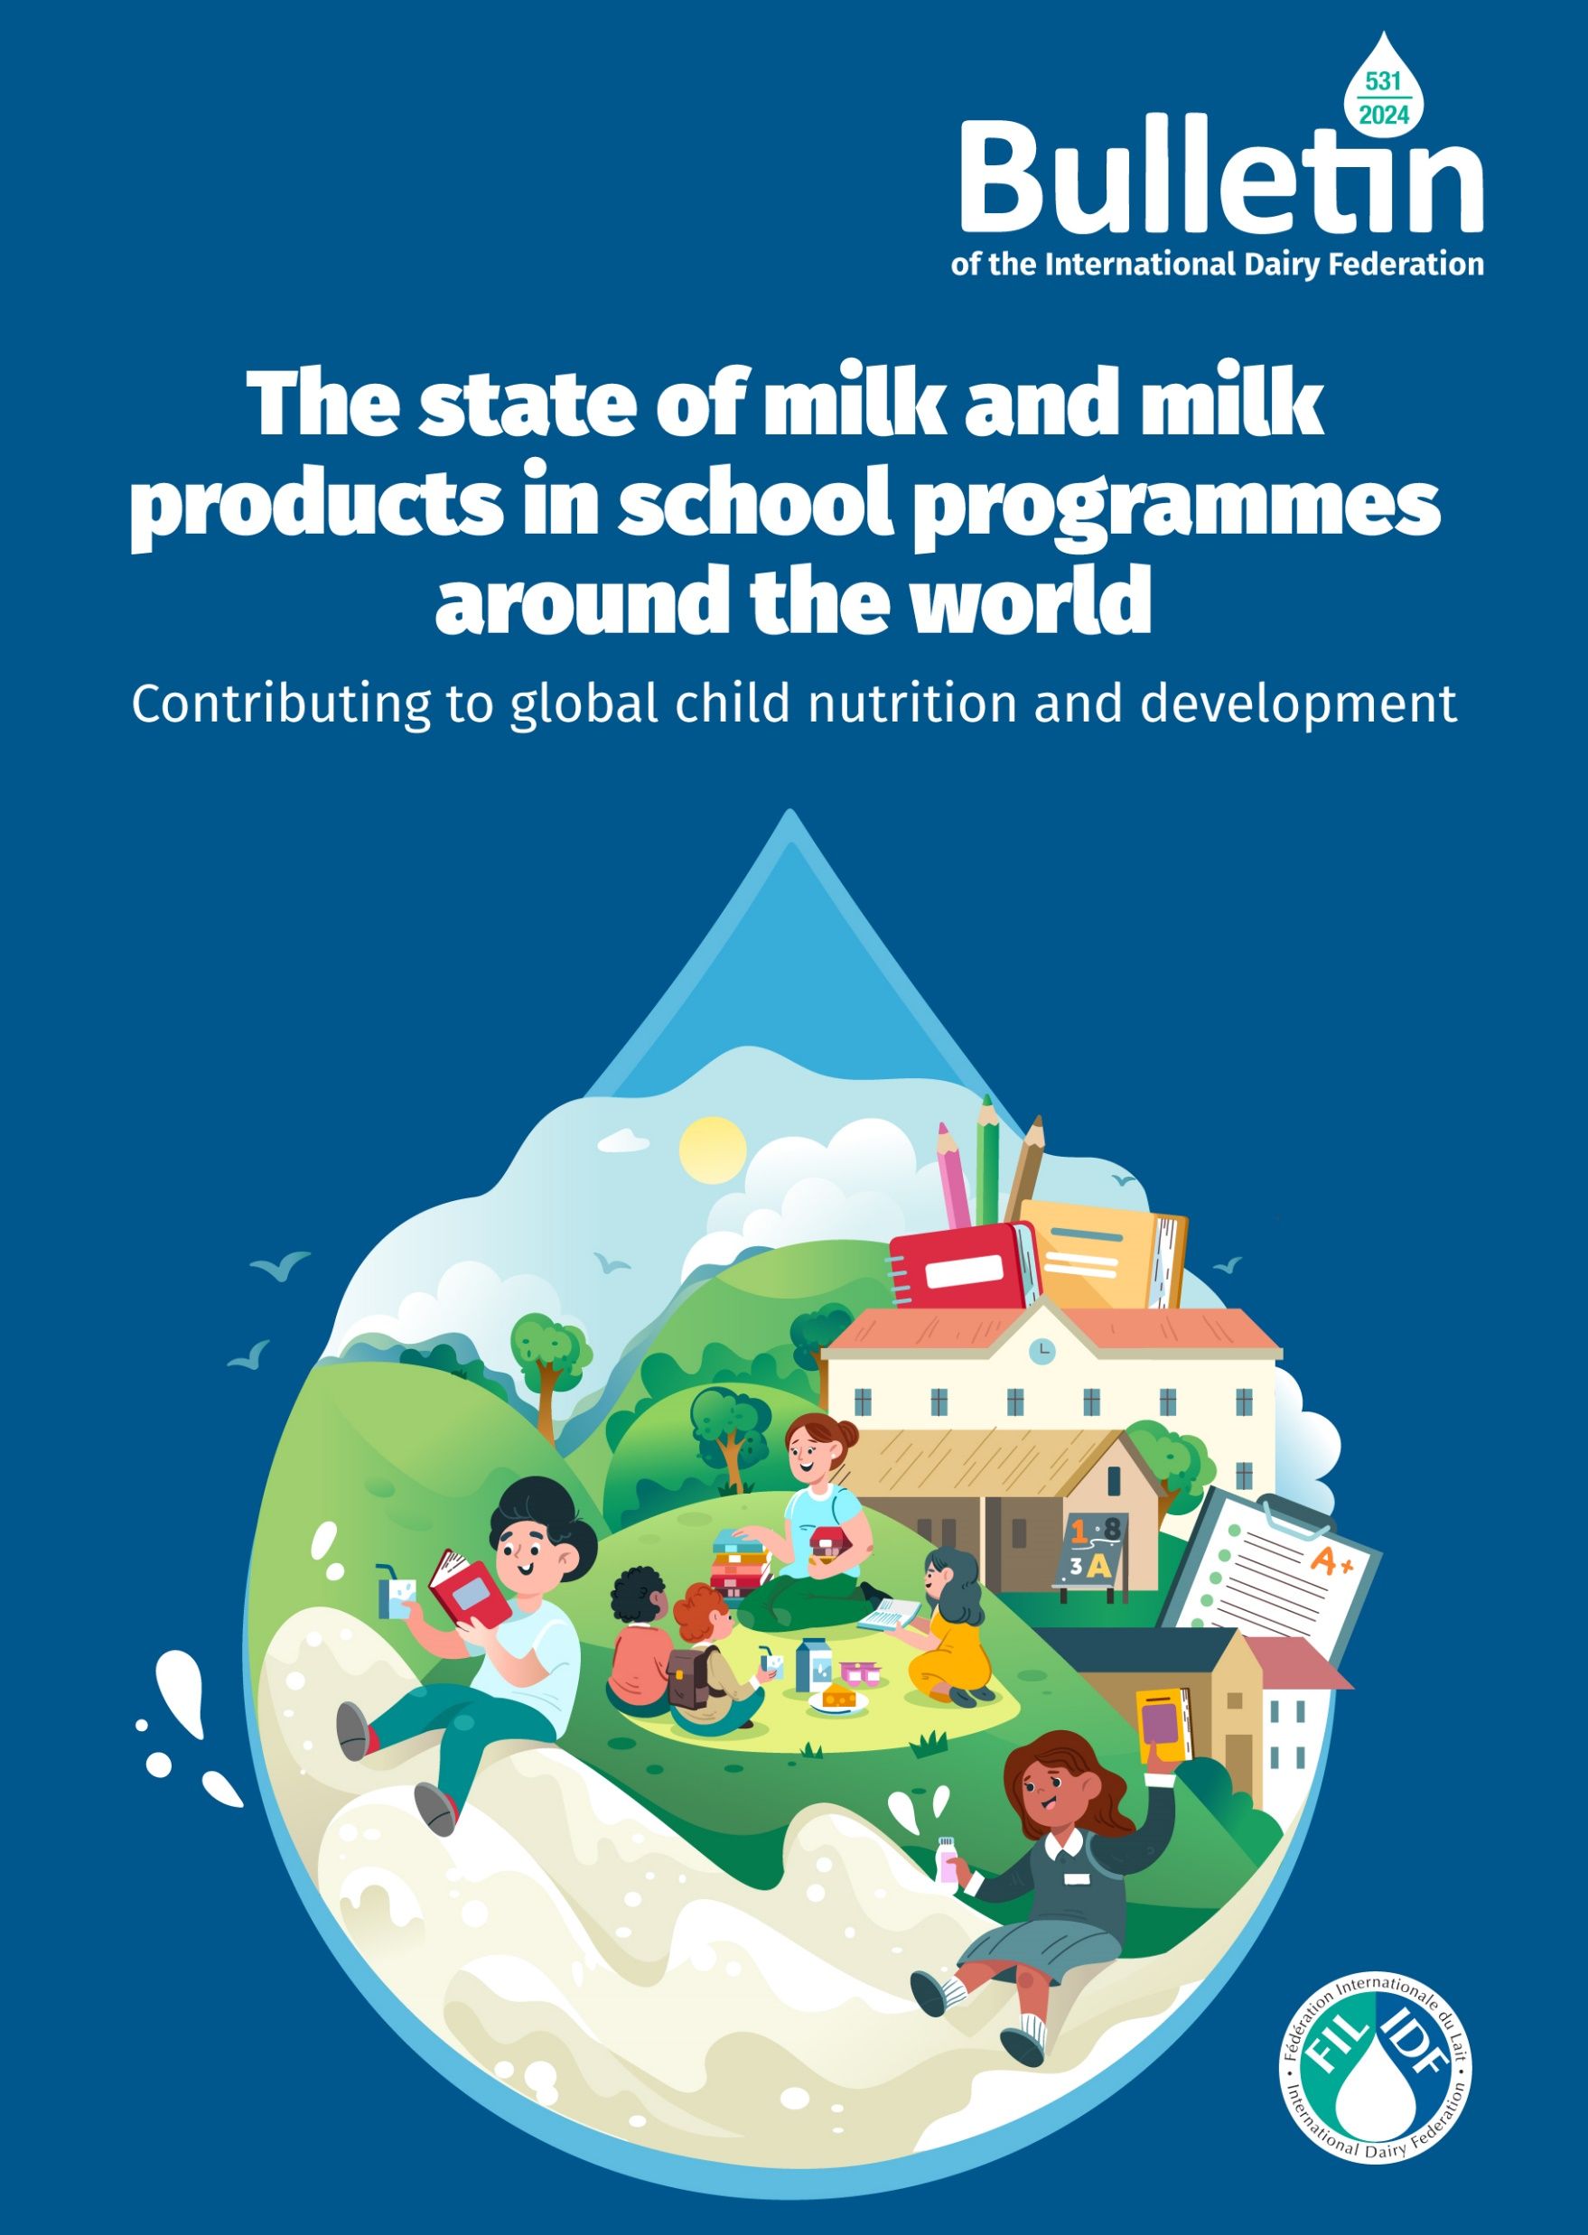
IDF BULLETIN ON SCHOOL MILK
Over 210 million children in 104 countries benefit from milk and milk products within school programmes*
Dairy foods are versatile and globally relevant
Geographical Representation of School Milk Coverage
Liquid milk (98%), yoghurt (48%) and cheese (32%) are the most commonly available dairy foods in school programmes
Twice as much unflavored dairy foods provided, compared to flavored options
Predominantly low-fat options, with whole and fat-free also available
*This analysis includes data from the IDF survey as well as data sourced from EU monitoring reports, the Global Child Nutrition Foundation, Tetra Pak, and other public sources.

Slide 28
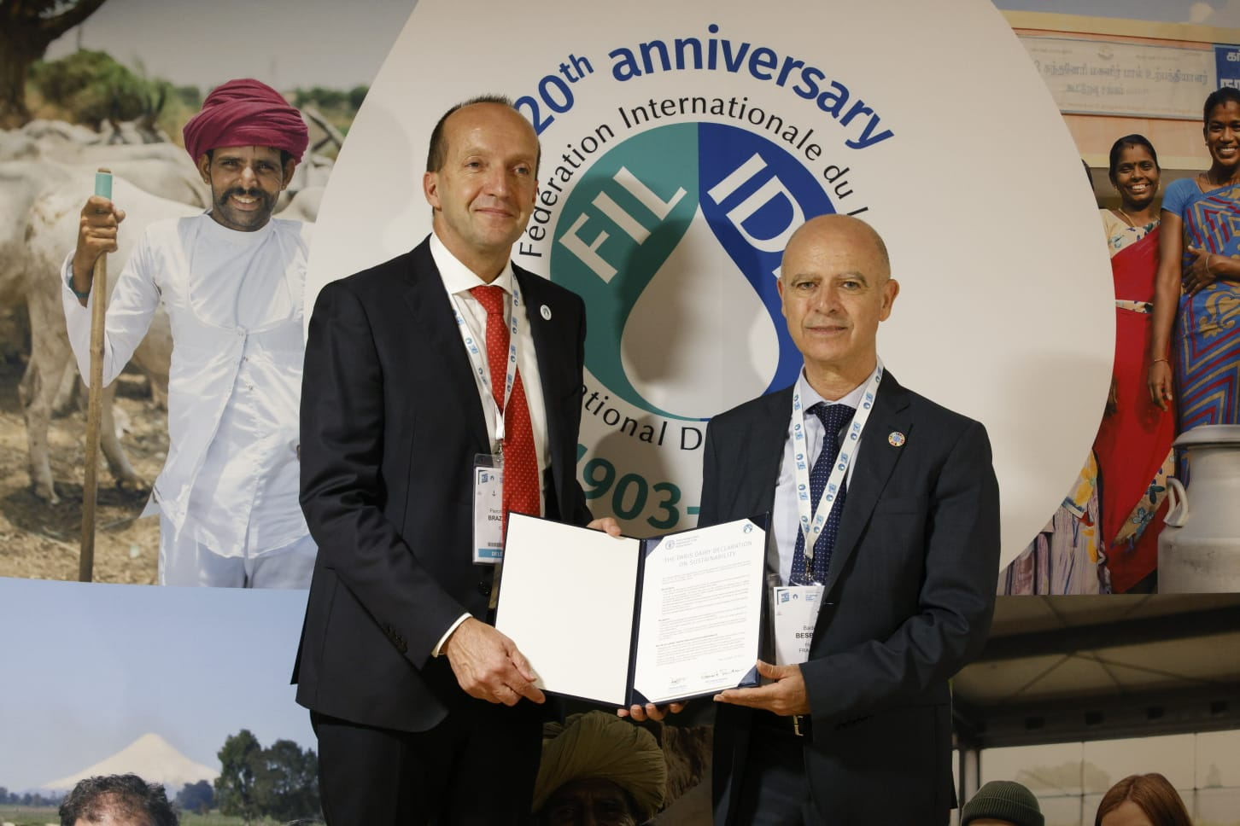
PARIS DAIRY DECLARATION ON SUSTAINABILITY
The dairy sector has shown strong commitment to sustainability
Global Dairy Agenda for Action (2009)
Dairy Sustainability Framework (2013)
Dairy Declaration of Rotterdam (2016)
Pathways to Dairy Net Zero (2021)
Global Methane Pledge (2022)
The Paris Dairy Declaration on Sustainability, signed by IDF and FAO in October 2024, solidifies a global commitment to sustainable dairy development with public, quantified, and time-tabled objectives.
IDF calls on all members, leaders, and stakeholders to endorse the Paris Dairy Declaration on Sustainability and commit to achieving its sustainability goals.

Slide 29
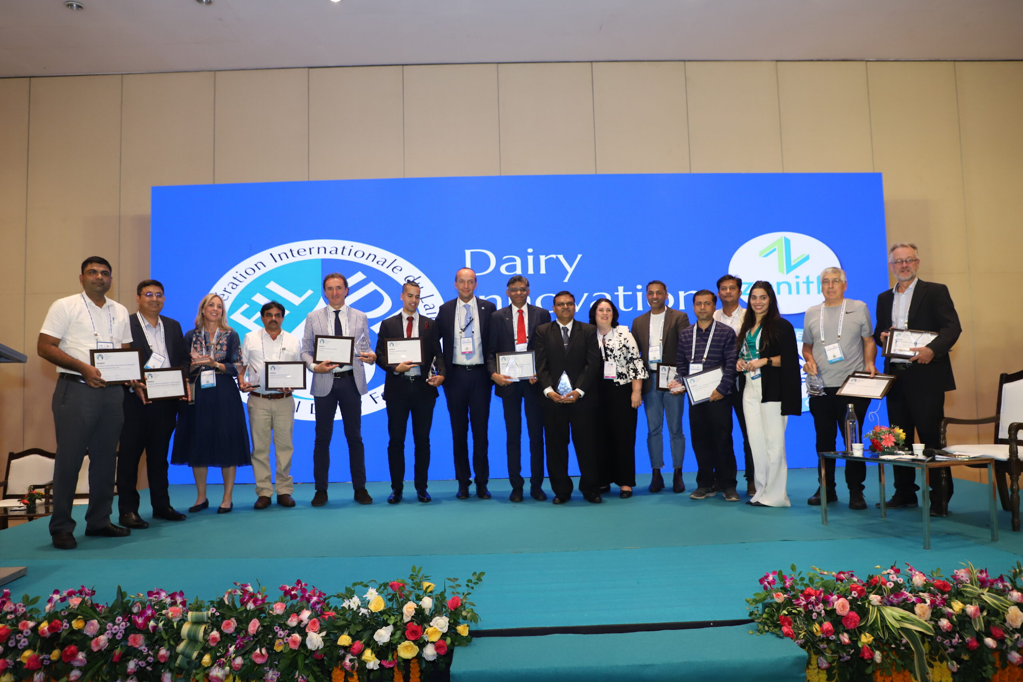
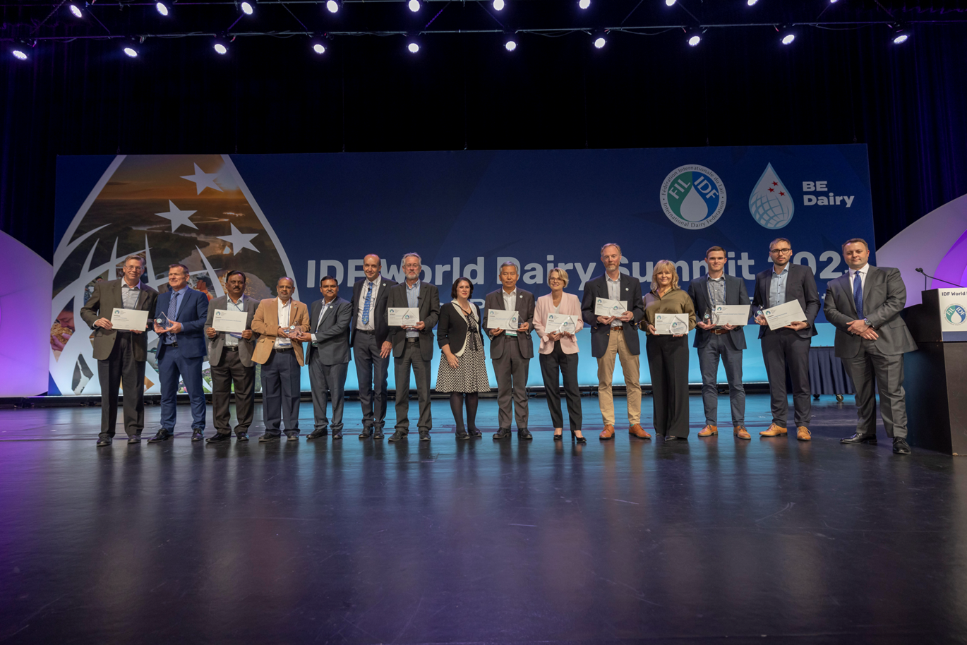
IDF DAIRY INNOVATION AWARDS BUILT-IN SUSTAINABILITY AND UN SDG’S

Slide 30
INTERNATIONAL DAIRY FEDERATION - WORLD DAIRY SUMMIT 2025

Slide 31
CONCLUSIONS
The global dairy sector stands for major challenges as forecasts show an increase in demand, with variable increase in supply.
Sustainability is not just about environmental stewardship but also involves ensuring economic viability and social equity. Pulling towards one of these dimensions will create trade offs.
The global sector is an innovative and resilient sector. Through sharing knowledge, science and expertise we can leverage the vast potential that sits within it.
Global challenges, local solutions
At IDF there is some work on other mammalian species but underrepresented.

Slide 32
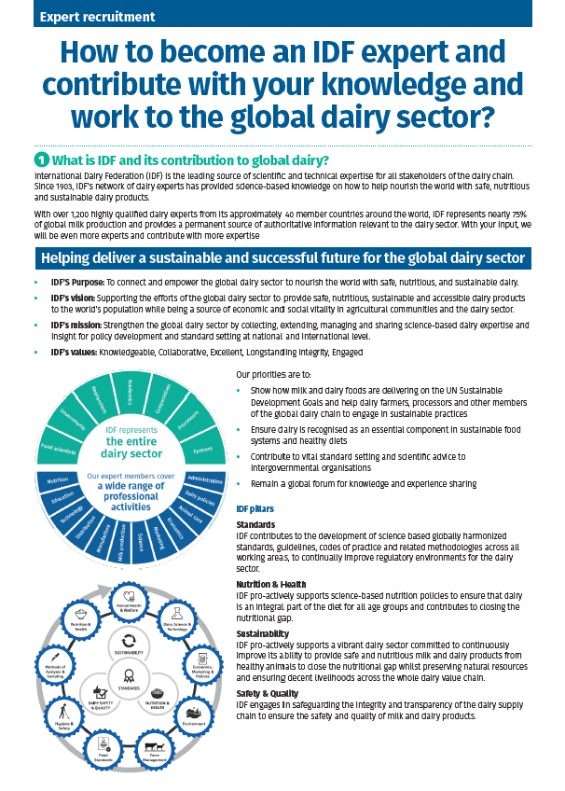
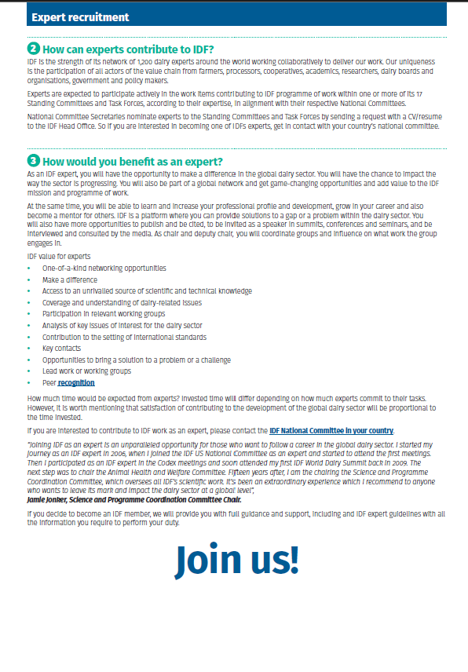
ENGAGE WITH IDF!

