Slide 1

India Dairy market
Development of exports potential

Slide 2


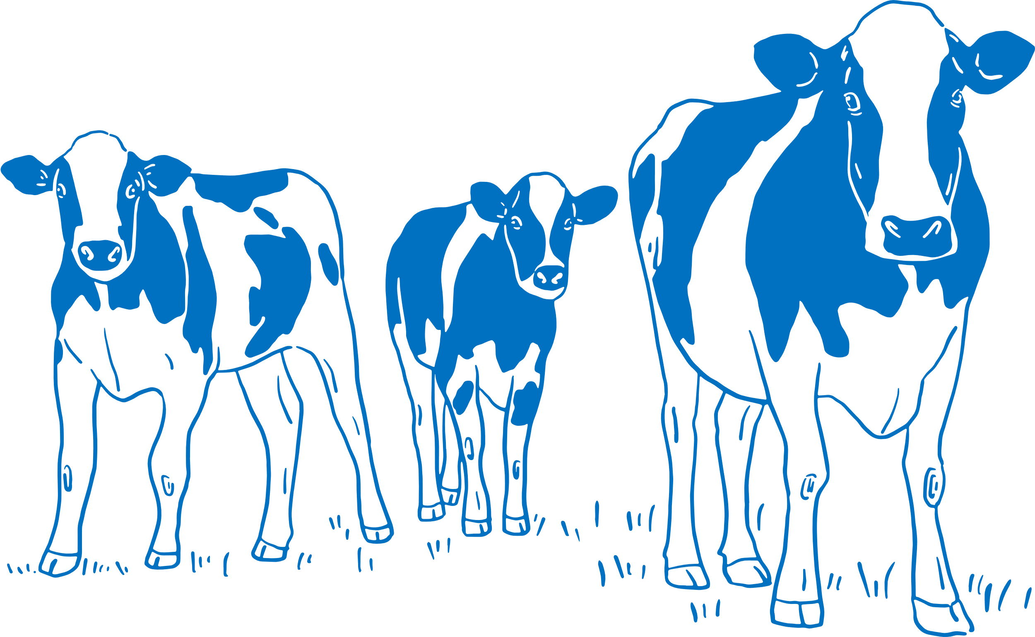

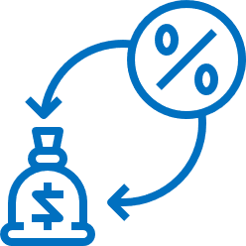





Overview
Culture
221 mmt
330 mn Cattle
≈70 mn farmers
2.4 kg/day
25% Organized
Milk is an integral part of Indian culture, and drinking milk and consuming milk-based products is considered auspicious and good.
India is the leading global milk producer
India is home to more than 300 million bovine females.
(Cows and Buffalo)
India is home to the largest number of dairy farms. With an average holding of 2-5 animals.
With an average daily milk yield per cow 2.4Kg (Equates to 876 kg/yr)
A largely informal market with only 25%
share in the “organized” sector
5% GDP
$320 bn
18% CAGR
Aspiration
Dairy is the single largest agricultural commodity contributing 5% of the national `GDP, witnessing 6.4% (CAGR) in the past 5 years.
Expected market size by 2030
Projected average for annual growth for the liquid milk and milk products market during the next 5-6 years
Major USA, Bangladesh United Arab EMTs, Bahrain, Malaysia, Saudi Arab and Qatar

Slide 3






Growth Drivers
Population
Demography
Incomes
Urbanisation
Formalisation
Interaction
At 1.42 bn, India is home to 18% of the global population, with a culture of milk production.
Around 50% of India's population is under the age of 25, which offers an impressive aspirational demand for health and well-being and the westernisation of diets.
Increasing per capita incomes are driving higher demand for high-quality dairy proteins
More than 35% of the Indian population lives in cities, increasing at a rate of .5 to 2.5 %pa. Urbanisation leads to demand for milk from organised value chain.
Rapid urbanisation, demand for better milk and better milk value are Increased formalisation and consolidation of the Indian Dairy Sector
Westernisation of diets, growth of pizza, QSR use of cheese, increase in eating outside the home.

Slide 4
Evolving products mix
in USD mn
Product | EBITDA Margin %
Whey (B2C) | 30 - 35
Curd | 18 - 22
Paneer | 18 - 22
Flavoured Milk | 16 – 18
Ice Cream | 15 – 18
Cheese | 14 – 18
Ghee | 10 – 15
Butter | 5 – 8
Milk | 3 – 5
Milk Powder | 0 – 2
Traditional products
growth
cagr
~15%
cagr 12.5%
cagr 23%
cagr 22%
Modern products
growth
cagr
> 20%
Product | ROCE Margin %
Milk | 44 - 48
Curd | 30 - 32
Cheese | 20 - 22
Ghee | 15 - 20
Butter | 5 – 10
cagr 23%
cagr 20%
cagr 24%
Source: Veda

Slide 5
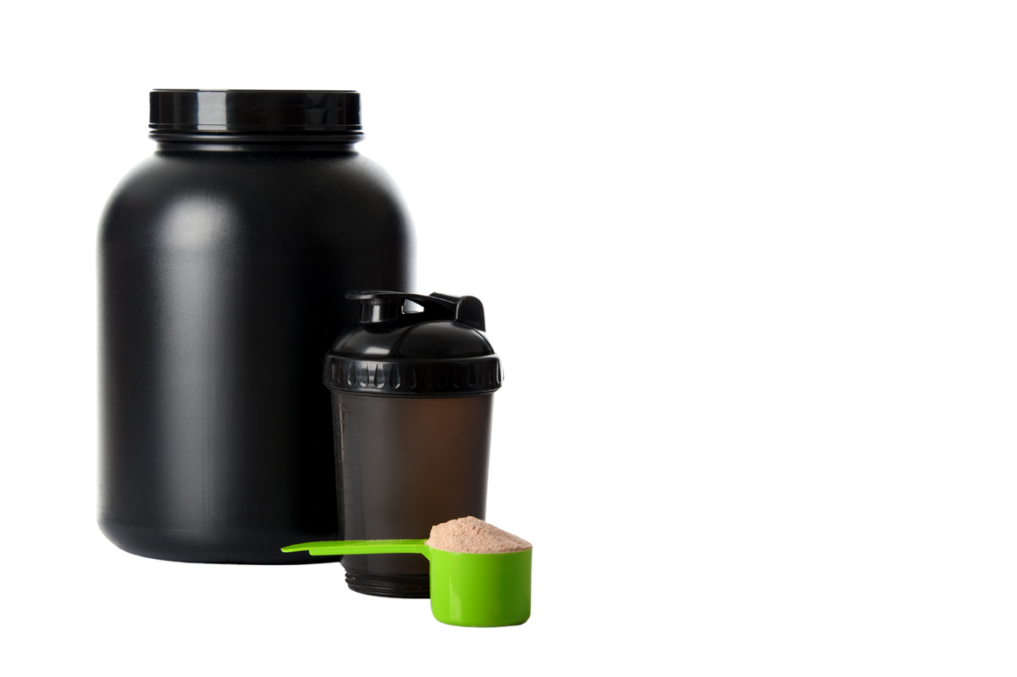

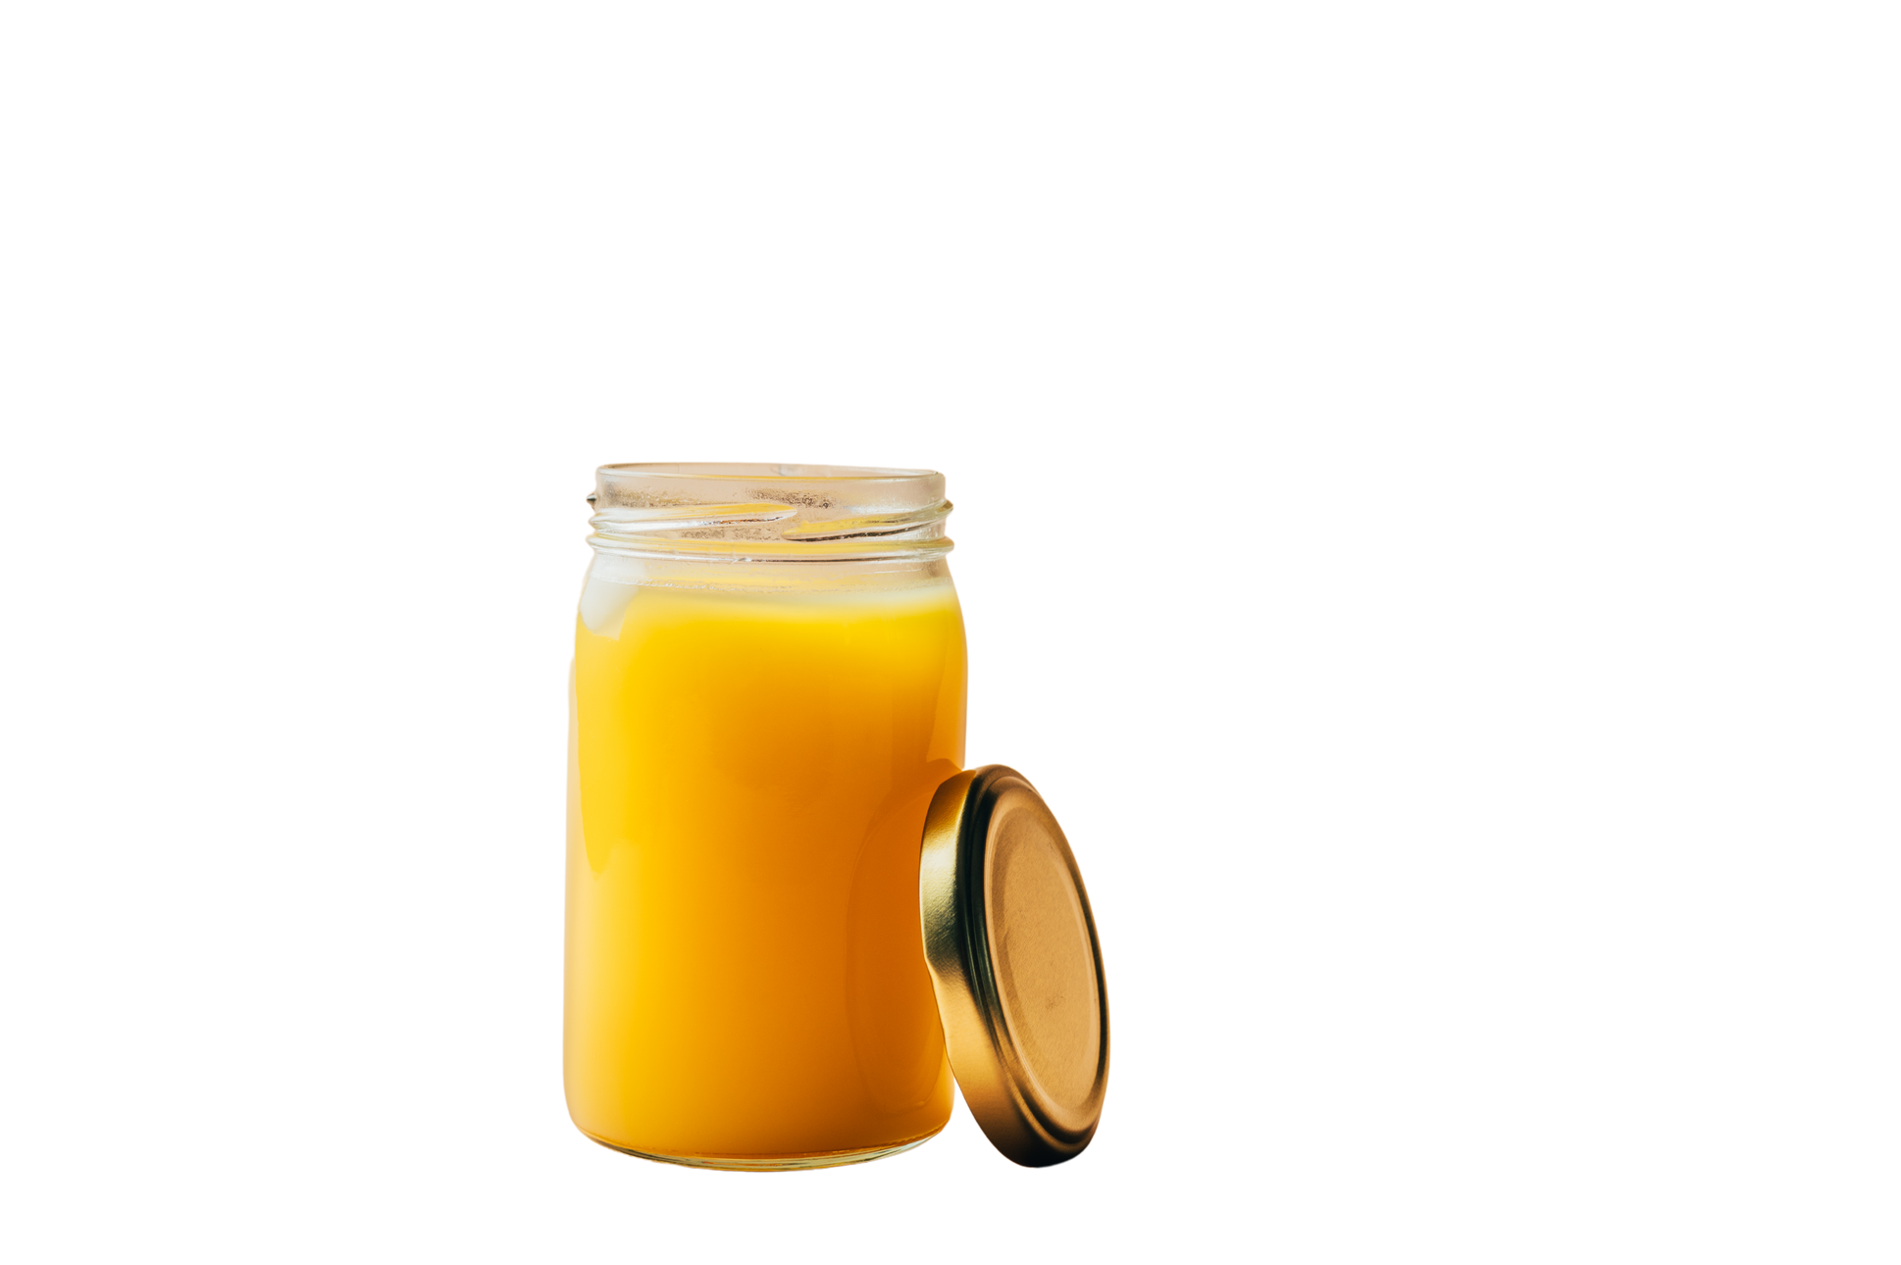
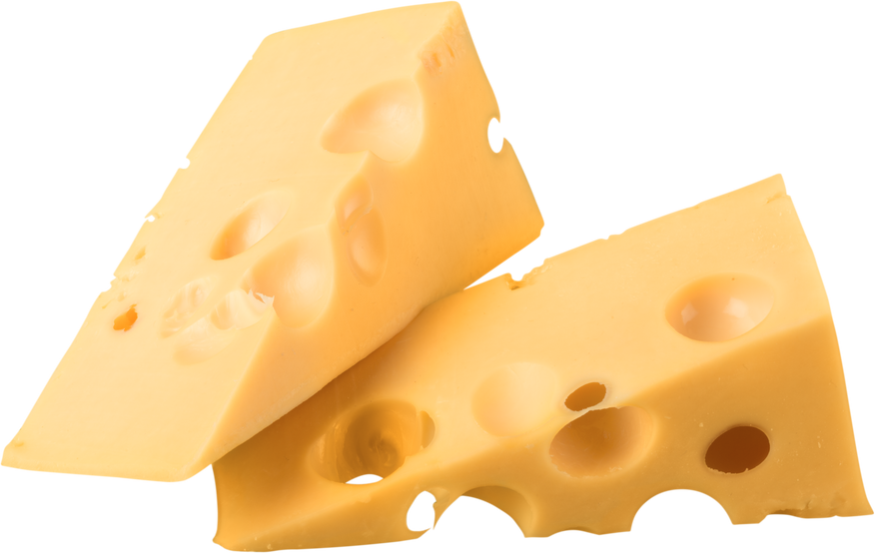
Expected growth by 2030
2030
280 m USD
14.5 b USD
15 b USD
10 b USD
Current
77 m USD
683 m USD
10 b USD
2.7 b USD
Source: IMARC, Industry interactions, Jordbrukare analysis.

Slide 6
Aspiration exporter
Source: GoI, Jordbrukare

Slide 7
Sensitive to imports
Applied duties range between 30% to 60%
Bound Duties, (maximum tariffs under WTO rules) range between 40% and 150%
Higher Bound tariffs allow the Indian government to control imports and internal prices
Imports volumes have remained quite small and inconsistent for commodities like milk powders and milkfat/ butter. Shows an increase only when there is a domestic shortage.
 | Tariff code | Tariff rate
Fluid Milk | 0401 | 30%
SMP | 0402 10 | 60%
Infant Formula | 0402 10 20 | 60%
Yoghurt | 0403 | 30%
Whey | 0404 | 40%
Butter | 0405 | 40%
Cheese | 0406 | 30-40%

Slide 8
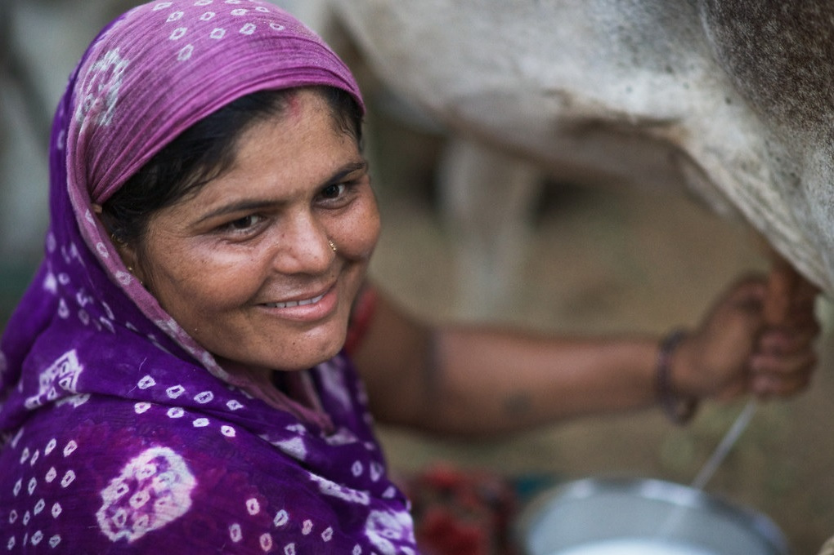
Part 2
Changing Landscape
17

Slide 9



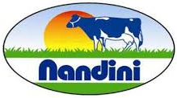



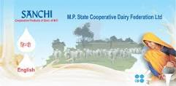
Cooperatives
FY22 (in USD mn)
India’s cooperative sector serves the mass market and sets the floor for raw material costs

Slide 10
























Emergence of the private dairy sector
FY23 sales (USD mn)
North
West
East
Hatsun Agro Product
South
Note: FY23 Revenue for some companies not available. Estimated revenues are provided for those companies.

Slide 11
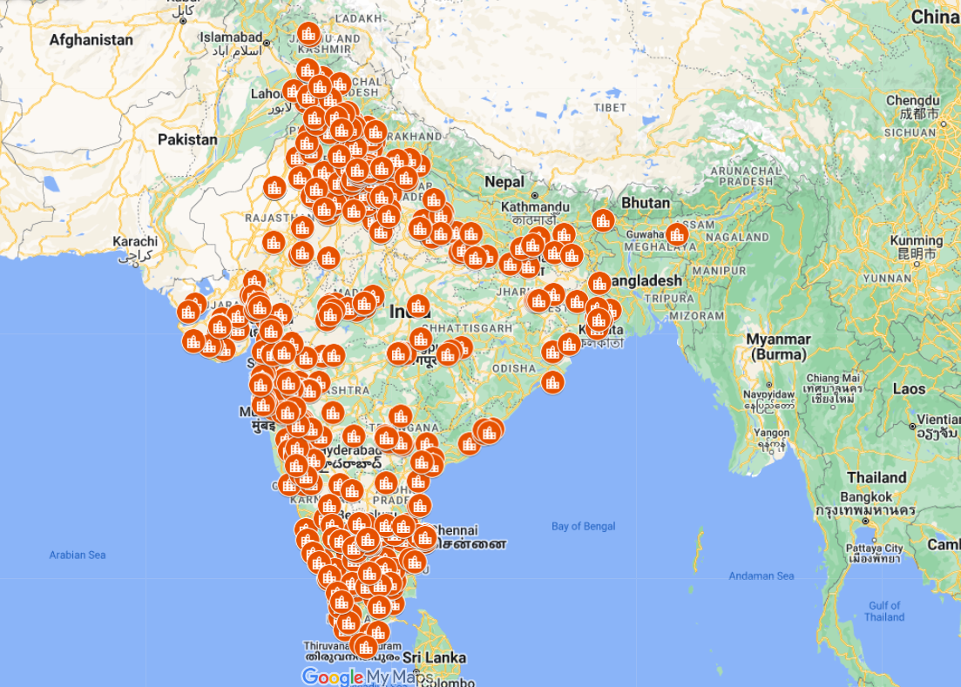
Improving processing infrastructure
DIDF
Commitments
US$2b dairy infrastructure fund to promote private investment and increase capacity by 50%
US$2b+ investment commitments from leading dairy players
Private
US$4b+ Investments coming from the private dairy sector
Value added,
Valorisation
Viability

Slide 12
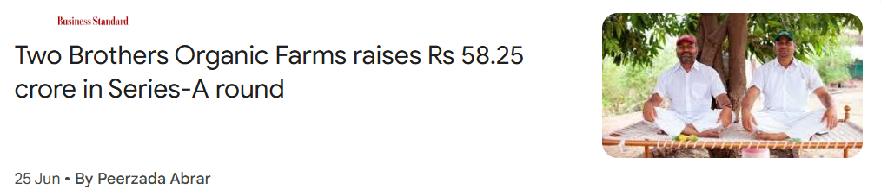
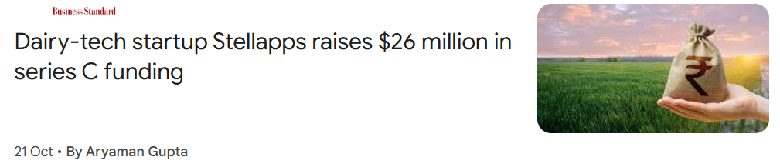
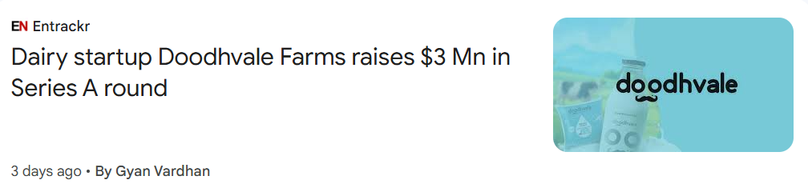
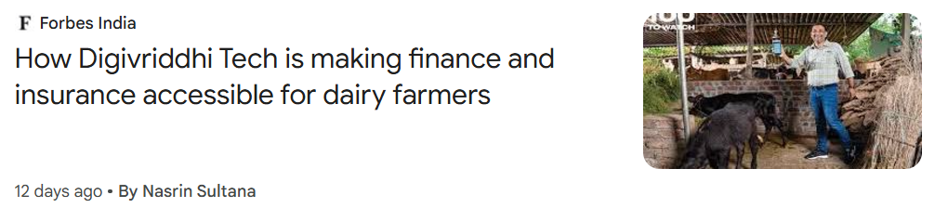
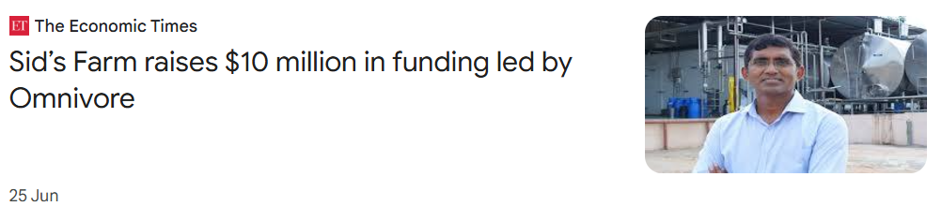
Changes on the farm

Slide 13
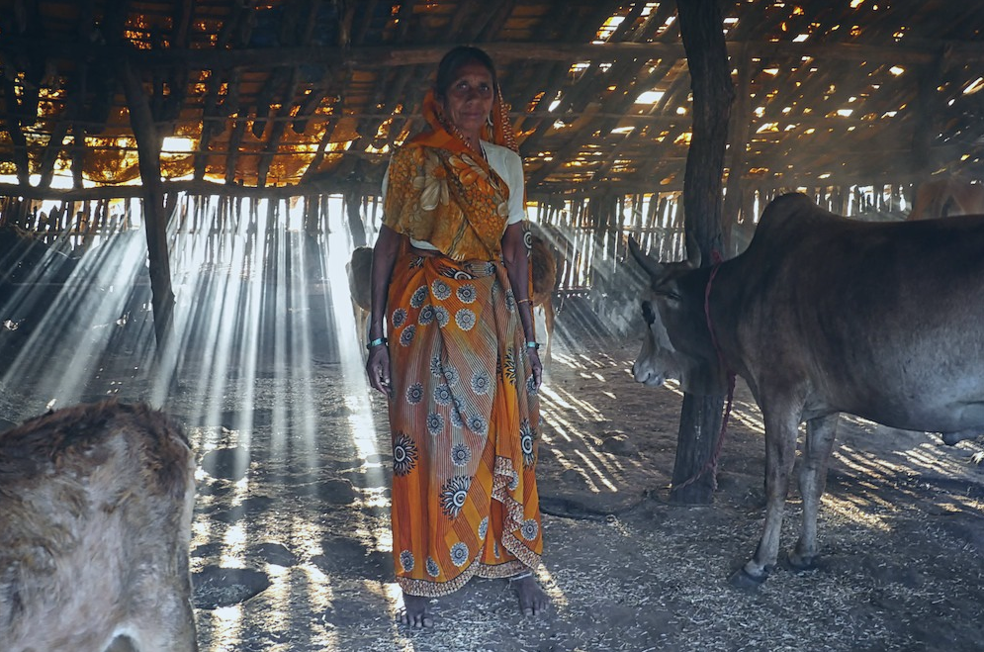
Part 3
The Challenges

Slide 14
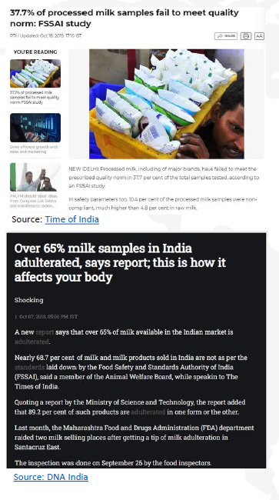
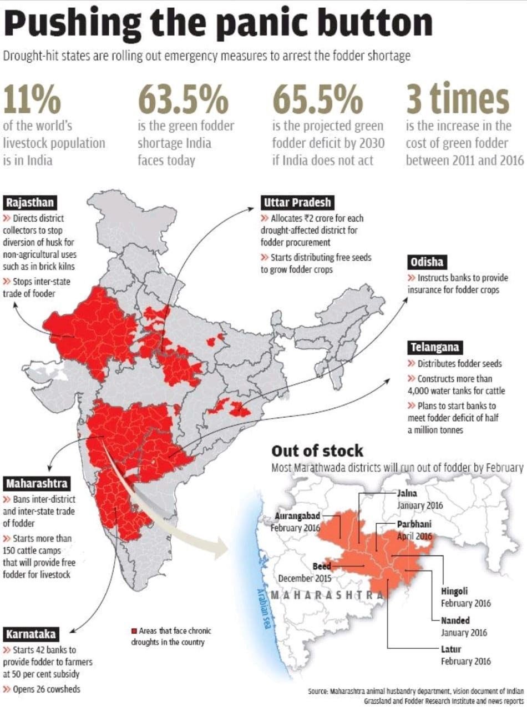
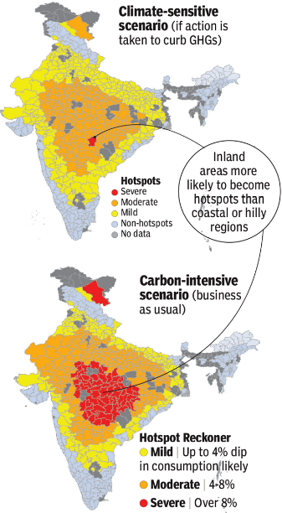
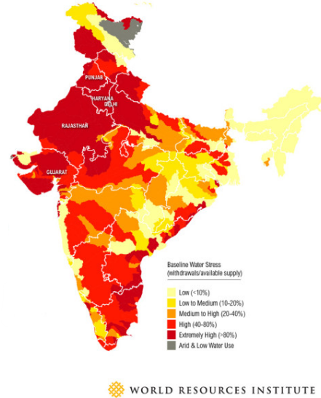
Key challenges
Milk Quality
Feed availability
Heat stress
Water stress
54% of India already suffers high to extremely high levels of water stress, including key dairy areas such as Gujarat

Slide 15
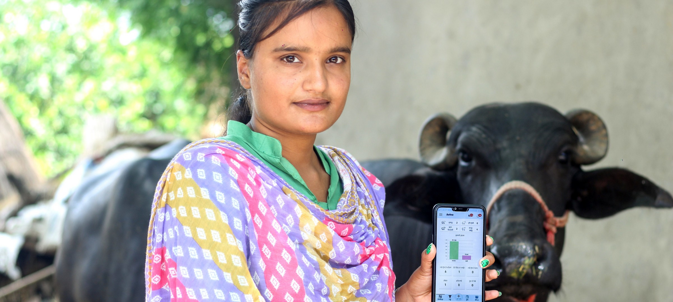
Part 4:
THE FUTURE

Slide 16
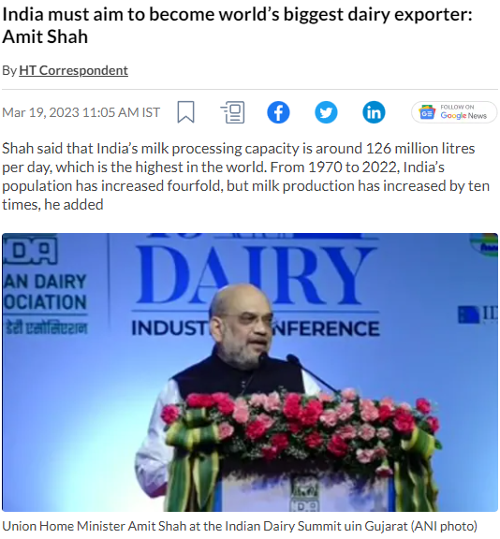
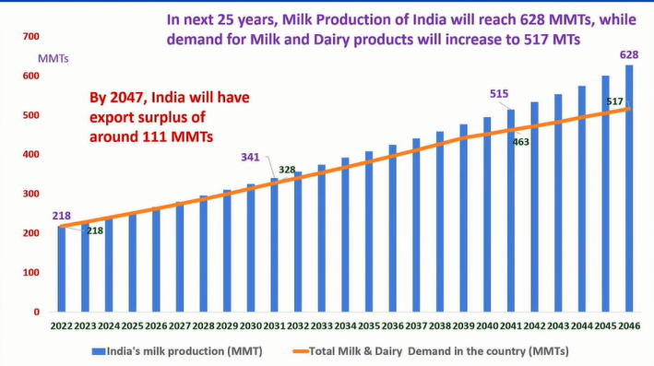
Aspirations
Governments Vision
Production and exports expectations
Source: Hindustan Times.
Source: PPT, RS Sodi at IDA Noida 2022.

Slide 17
Outlook
BAU
HIG
HYG
In a business-as-usual (BAU) scenario, that is the continuance of the recent economic growth (6.34%)
Income growth is higher than the current growth rate and stays between 7% or 8%
In the HYG scenario, milk yield may increase to 10.11 kg/day in 2047-48

Slide 18
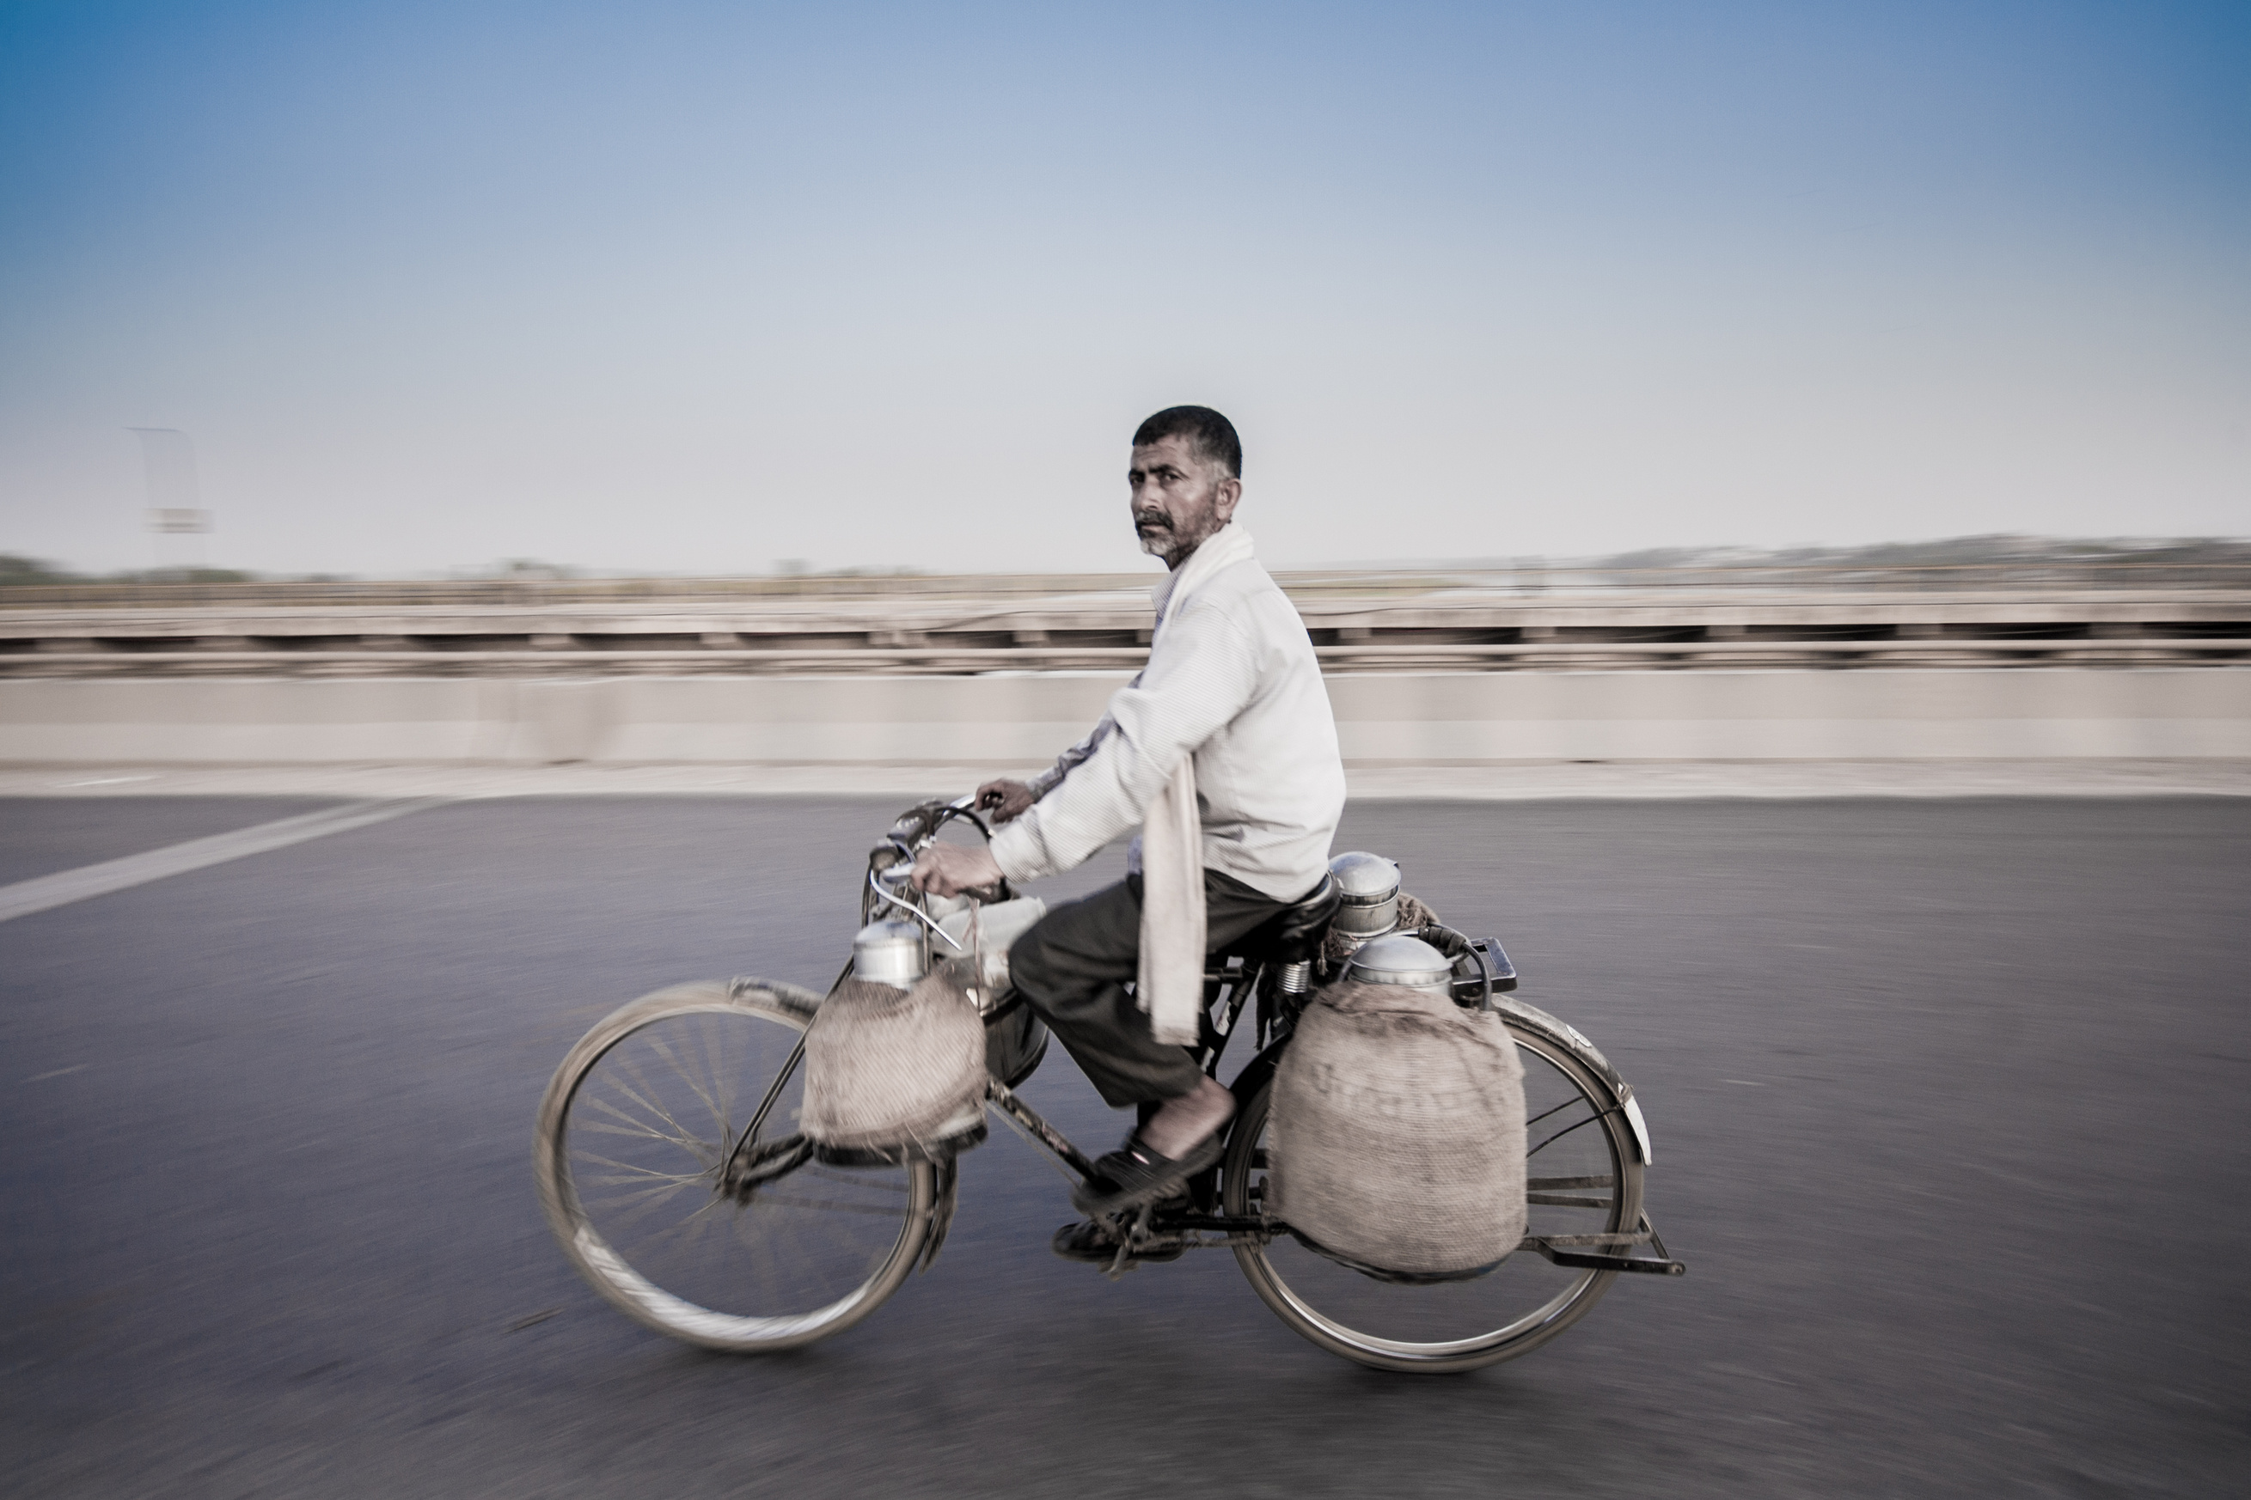

Conclusion
Changing Interaction with Milk
Robust dairy demand challenging supply.
Businesses aspire to better valorize their milk and hence are keen to export.
Poised to become a net importer in the medium term.
Rate of farm consolidation will pave the way for robust and resilient Indian Dairy Sector
Download PPT
Thank You

